Slide 1
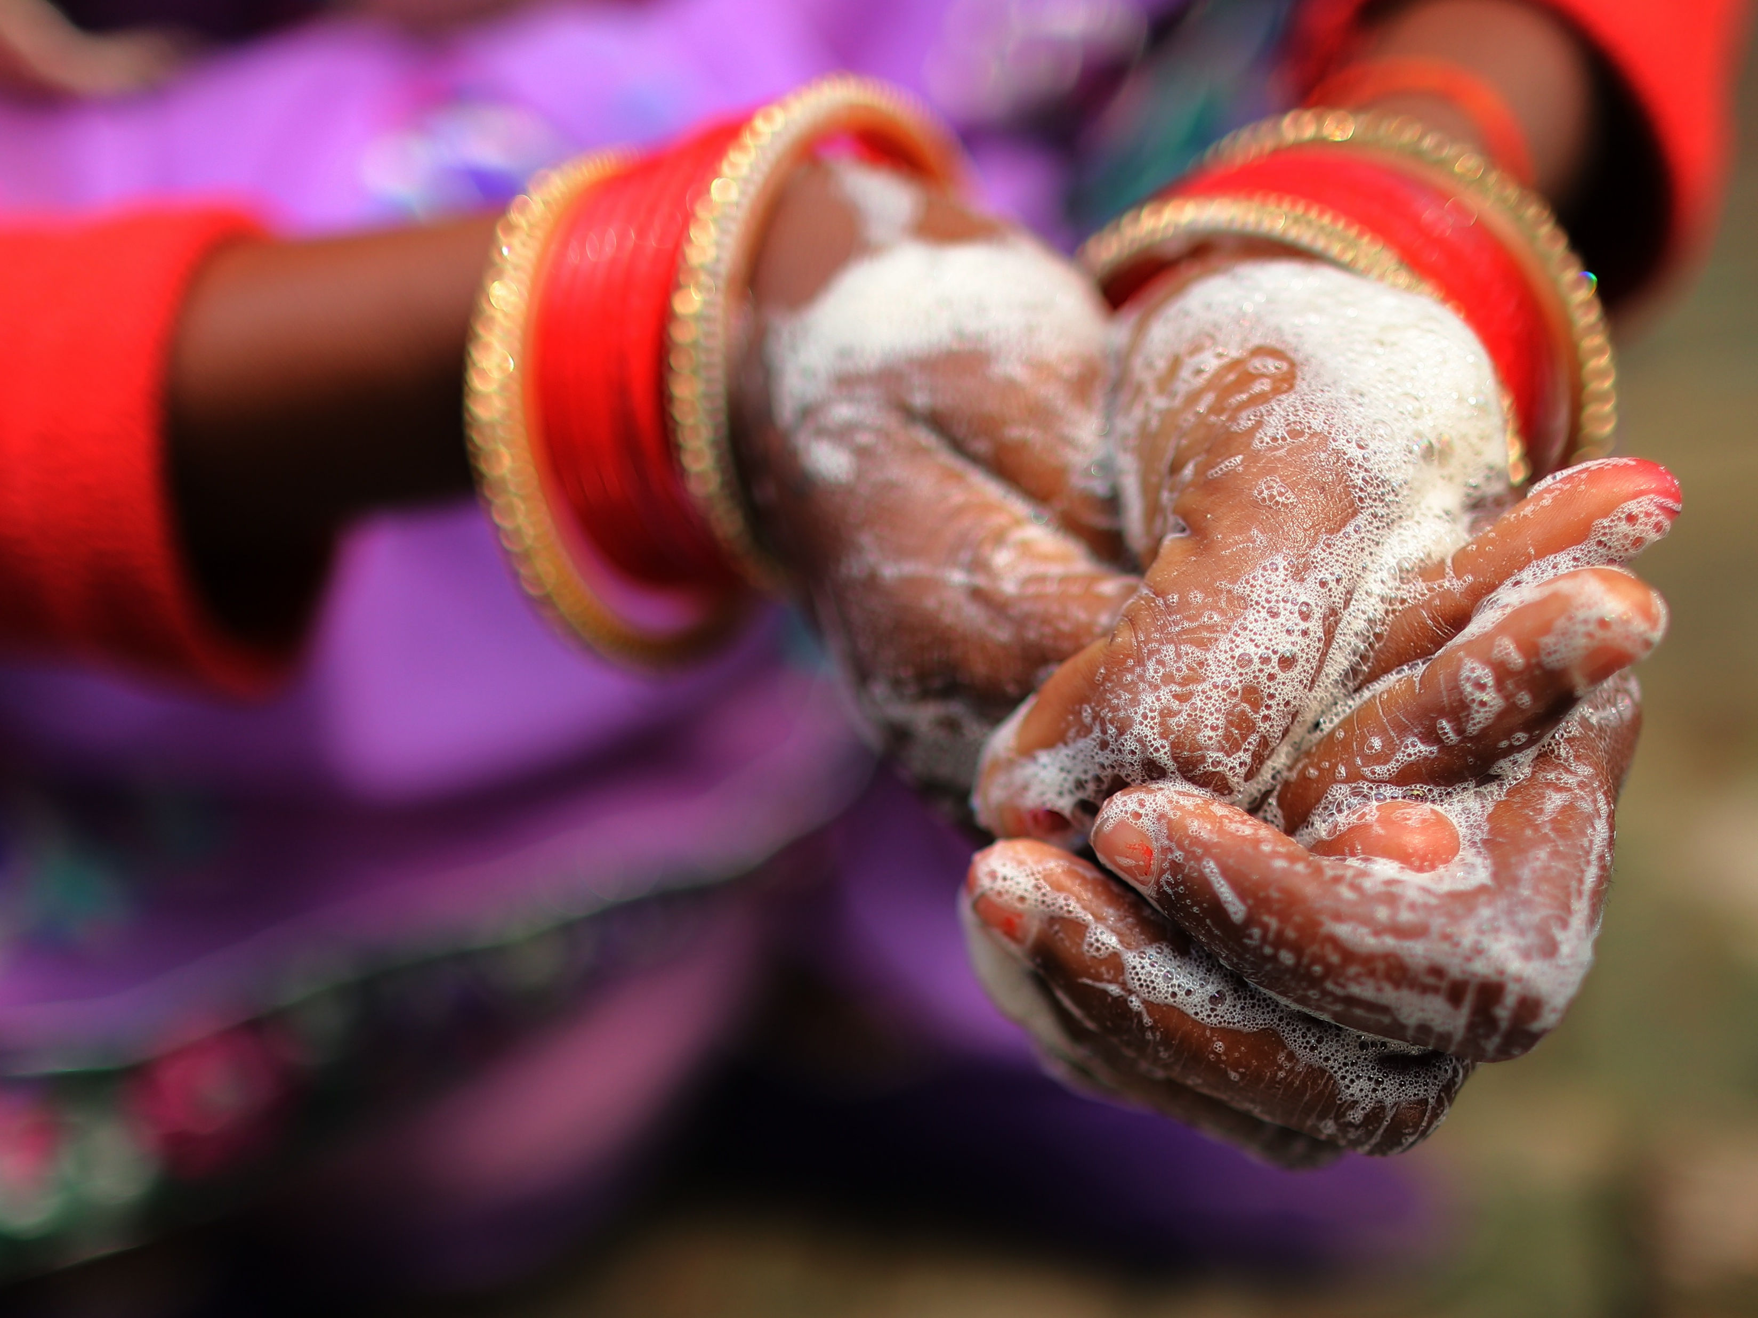
2024
Global Handwashing
Partnership Annual Report
Photo Credit: WaterAid

Slide 2
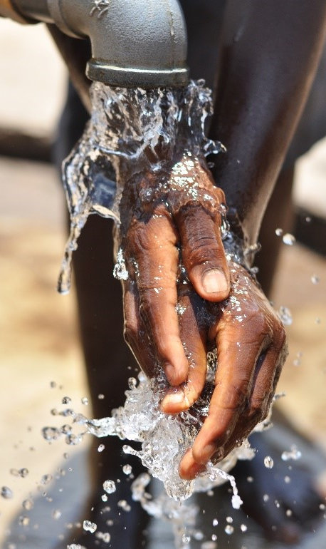
Table of Contents
About the Global Handwashing Partnership…3
Why Hand Hygiene……………………….……………….……4
Activity Highlights……………………..…………….5
Advocacy Highlights……………………………………………7
Knowledge Management Highlights..……….…….…15
Coordination Highlights…...…………..………………..…..20
Partner Spotlights…………………...…………..….25
Way Forward………………………………………….30
Photo Credit: FHI 360

Slide 3







About the Global Handwashing Partnership
The Global Handwashing Partnership is a public-private partnership working to advance handwashing with soap as a fundamental component of global health and community development. To achieve our vision of universal hand hygiene, the Global Handwashing Partnership supports the prioritization of handwashing with soap within programs, strategies, and policies at the local, national, and global level.
As a global advocate and knowledge hub, the Global Handwashing Partnership engages a broad network of hand hygiene champions with partners from government agencies, multilateral organizations, private corporations, nongovernmental organizations, and academic institutions. Steering committee members are listed in Figure 1 to the right, with a full list of partners available at the end of this report.
Figure 1. 2024 Steering Committee Members

Slide 4
Why Hand Hygiene?
Hand hygiene is a fundamental practice for maintaining health and preventing the spread of infectious diseases. Our hands encounter numerous surfaces and objects throughout the day, picking up germs that can cause illnesses such as gastrointestinal and respiratory infections with impact ranging from an annoying illness to death. By washing our hands regularly with soap and water, we can effectively remove these harmful pathogens and reduce the risk of infection. This simple yet powerful act is a cornerstone of public health and personal well-being.
Having a dedicated platform to focus on hand hygiene is crucial because it is one of the most cost-effective and accessible methods to prevent disease transmission. In healthcare settings, proper hand hygiene can prevent up to 50% of infections acquired during medical care. In the community, regular handwashing can reduce the incidence of respiratory infections by 16-21% and
gastrointestinal infections by 31%. These statistics highlight the significant impact that hand hygiene can have on reducing the burden of infectious diseases.
Beyond health, hand hygiene has broader implications for education, child development, and economic opportunity. Children who practice regular handwashing are less likely to miss school due to illness, which supports their academic performance and overall development. In workplaces, good hand hygiene can reduce absenteeism and increase productivity. By preventing diseases that hinder development and economic participation, hand hygiene contributes to a healthier society with associated improved well-being.
Ultimately, good hand hygiene creates a safer and healthier future for all. The Global Handwashing Partnership is dedicated to working together to achieve universal hand hygiene and ensure good hand hygiene remains a mainstay in public health interventions.

Slide 5
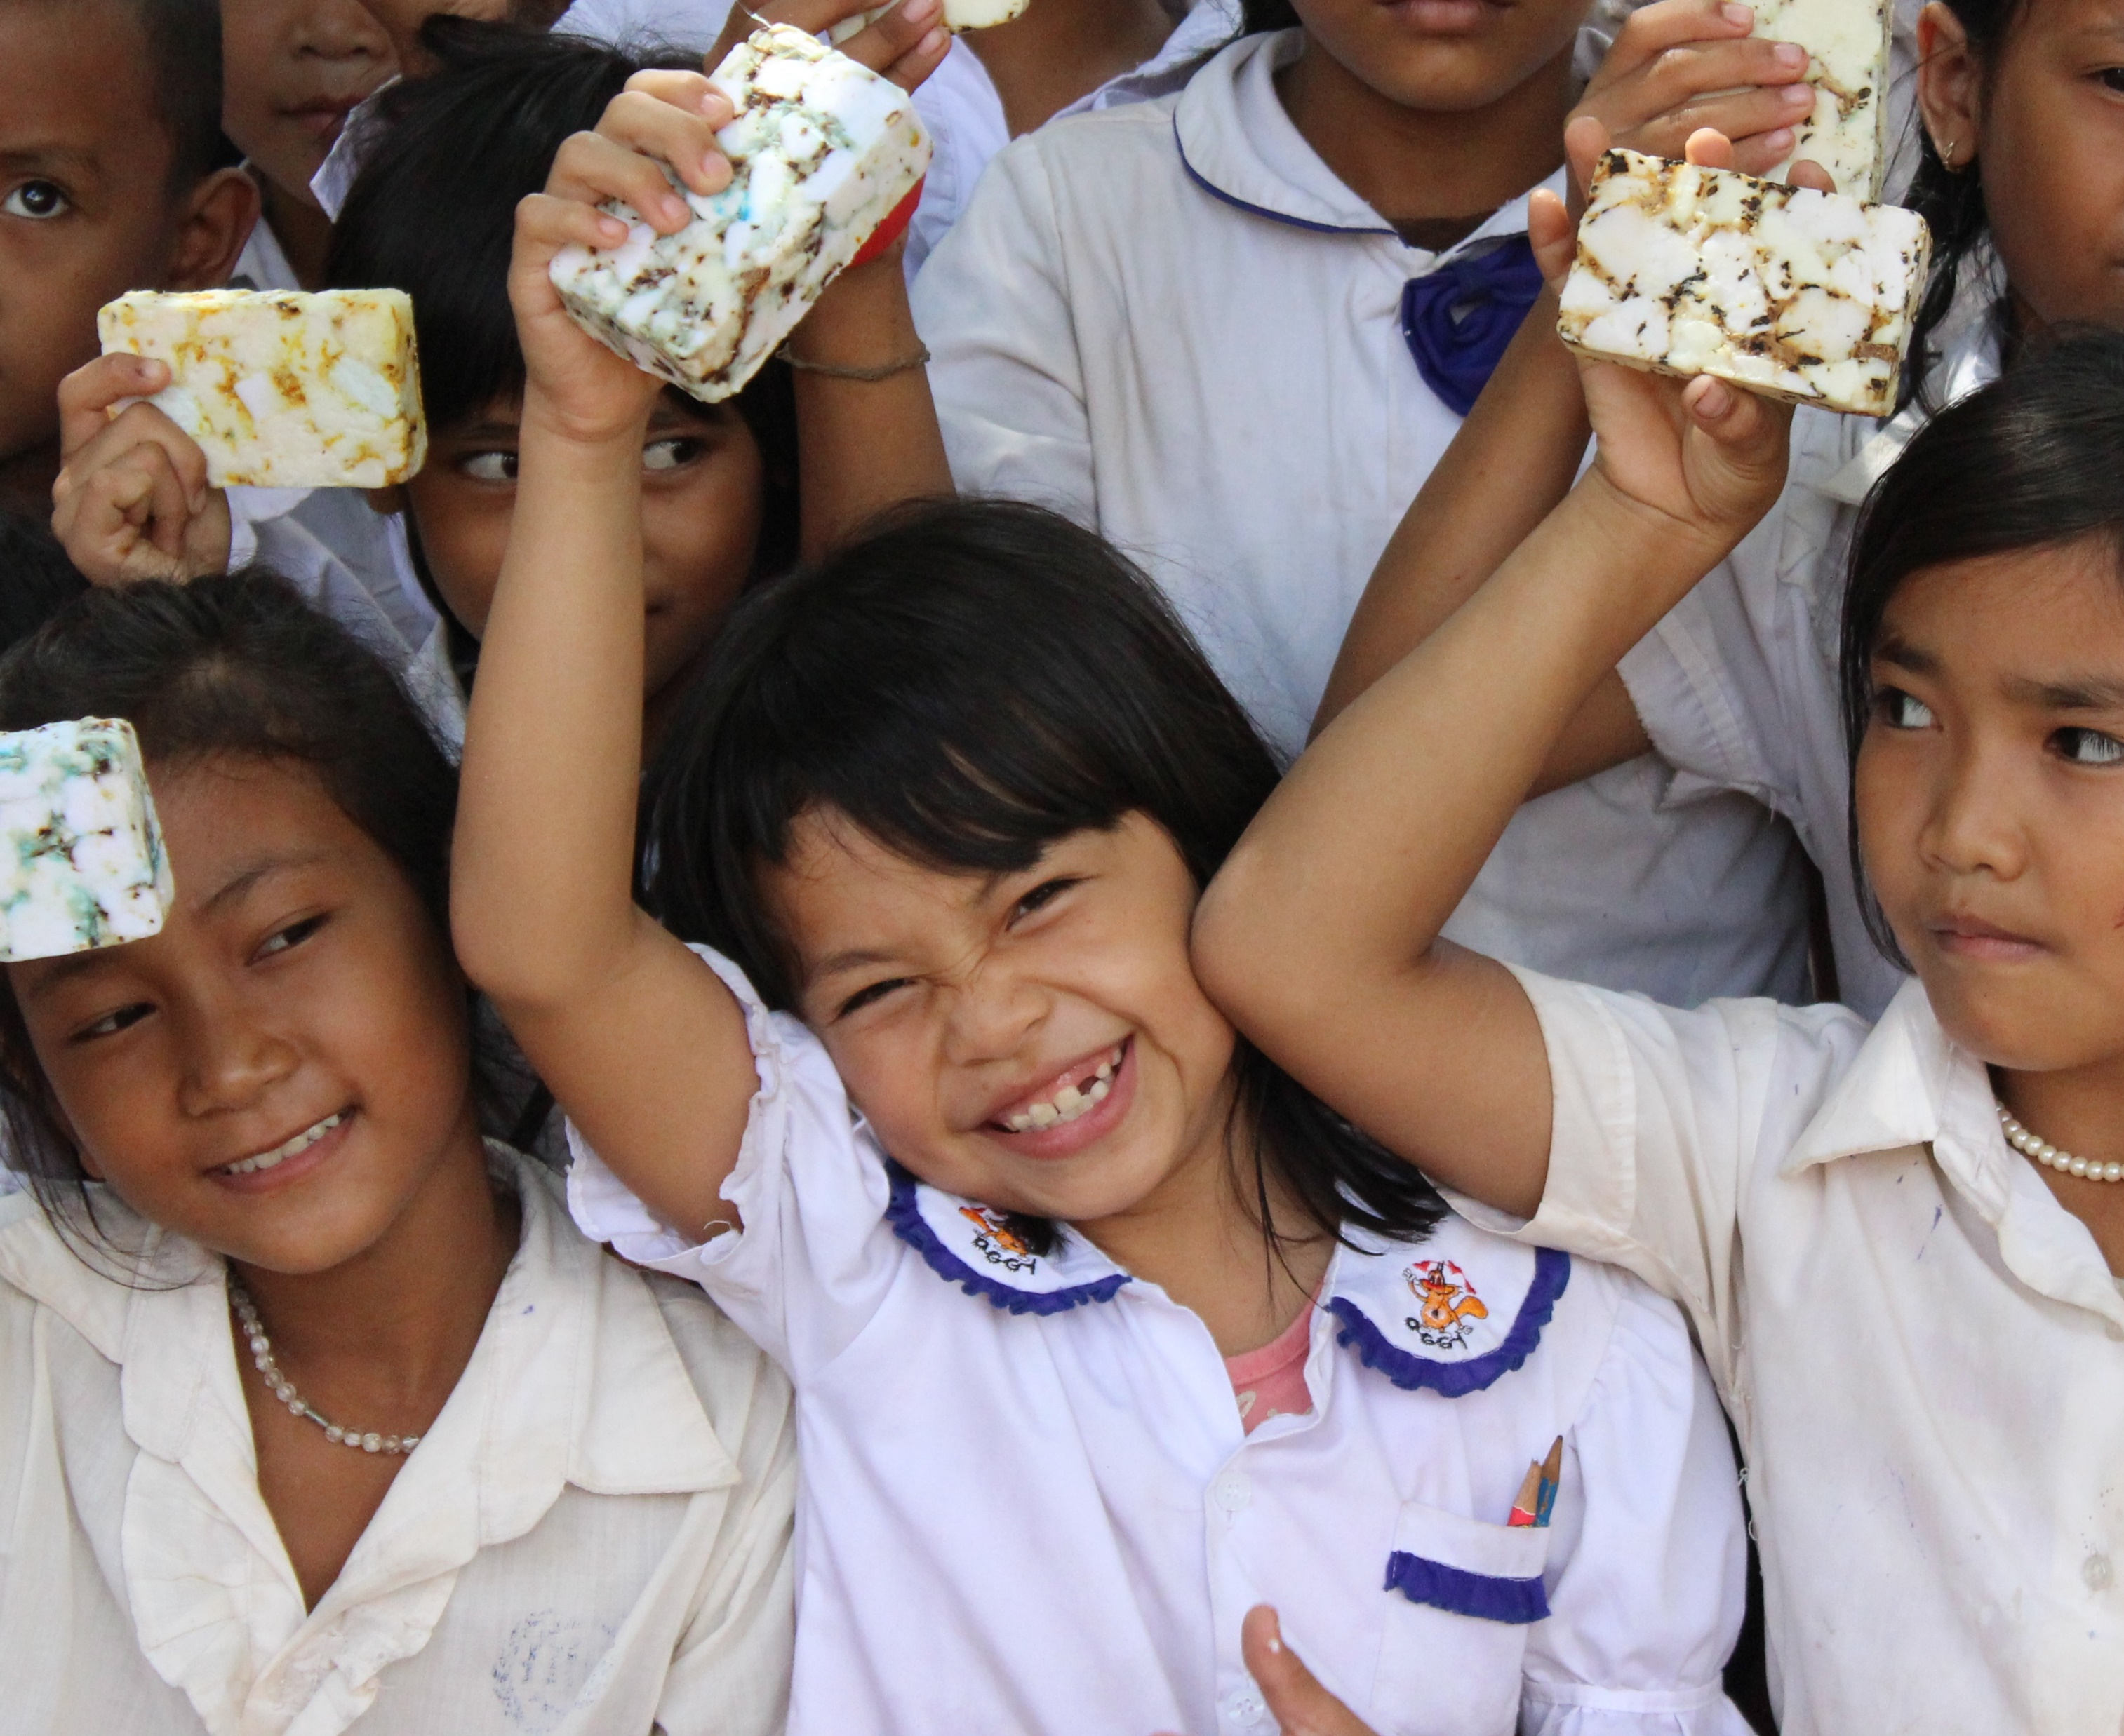
ACTIVITY HIGHLIGHTS
Photo Credit: EcoSoap Bank

Slide 6
2024 Activity Highlights
In accordance with the 2020-2024 strategic plan, the Global Handwashing Partnership implements activities based on its mission and strategic objectives, highlighted below.
This report reflects advocacy, knowledge management, and coordination highlights implemented throughout the year. While the objectives and supporting activities of the Global Handwashing Partnership are broken down into three objectives (left), it should be noted that activities often support two or three of these goals, demonstrating the interconnectedness of the partnership’s objectives.
Reporting activities allow the Global Handwashing Partnership to track progress toward its mission, which is to improve global health and community development by acting as the preeminent global advocate and knowledge hub on handwashing and hand hygiene programming to achieve its vision of clean hands for all.
Promote clean hands for all through advocacy efforts
Serve as a knowledge hub to share evidence and resources on handwashing and hand hygiene programming
Ensure the Global Handwashing
Partnership is sustainable
for the long-term

Slide 7
Advocacy Highlights
Global Handwashing Day
Global Handwashing Day, celebrated annually on October 15, is a global advocacy day dedicated to promoting the significance of handwashing with soap. It serves as a platform to engage key stakeholders at local, regional, and global levels.
Integrated advocacy
Hand hygiene is a cross-cutting issue with impacts across multiple sectors. It is critical to mainstream focus on hand hygiene beyond traditional water, sanitation and hygiene (WASH) actors and build advocates within related sectors, such as nutrition, education, and health.
Key Messages and Events
Key events provide important platforms to amplify key messages for hand hygiene. Key moments and events, such as World Hand Hygiene Day and various conferences and convenings, serve as crucial opportunities to advocate for hand hygiene.
7

Slide 8
Global Handwashing Day
Global Handwashing Day is an annual global advocacy day celebrated every October 15. The day is dedicated to promoting handwashing with soap and elevating the issue at the local, regional, and global level.
Every year, the Global Handwashing Partnership leads the planning, facilitation and reporting of Global Handwashing Day. Since its inception in 2008, Global Handwashing Day has evolved from a day of awareness to a day of action.
This year’s theme, “Why are clean hands still important?,” encouraged celebrants to reflect on the importance of handwashing with soap. The use of a question for the 2024 slogan aimed to evoke more discussion and responsive action among celebrants, encouraging people to answer with the value of handwashing with soap in their own lives.
WASH. Wash your hands with soap at key moments to prevent infections and the spread of disease.
LEAD. Promote handwashing with soap in your community.
ADVOCATE. Advocate for and ensure handwashing facilities with soap and water are available and accessible in public settings.
PARTNER. Partner with others to promote handwashing with soap to maximize your impact.
8

Slide 9
Taking Action
Furthermore, Global Handwashing Day called on academics to fill hand hygiene evidence gaps and translate their research into practical resources for hand hygiene intervention and program development.
No matter the role, everyone can make a difference to improve handwashing with soap. Global Handwashing Day serves as an important platform to reinforce messages and drive commitments for change.
Building on the momentum from previous years, this Global Handwashing Day called on governments to prioritize integrating and budgeting for hand hygiene in national response and resilience plans, as well as long-term development strategies. And, for donors to invest in programs that prioritize hand hygiene, promoting access to hand hygiene facilities, and contributing to both public health and economic resilience.
This year’s Global Handwashing Day also acknowledged the role institutional actors play. Product suppliers should collaborate with governments, health systems, and NGOs to ensure sustainable supply chains for hand hygiene products; all businesses should prioritize hand hygiene for employee health and safety; and institutions should implement a multi-faceted approach for hand hygiene, including promotion, accessible facilities, regular monitoring, and behavior reinforcement.
Creating Clean Hands
We believe the biggest change makers are the next generation. To increase engagement for Global Handwashing Day, the Global Handwashing Partnership conducted its second-ever Creating Clean Hands youth contest. The contest aimed to encourage youth (18 years or under) to express their ideas and creativity through a graphic promoting clean hands. More details on this year’s contest can be found here. This year’s winners include Kwame from Ghana, Eden from the USA, and Emrul from Bangladesh. Congratulations changemakers!

Slide 10

Annual Event
On top of planning Global Handwashing Day each year, the Global Handwashing Partnership has also hosted an annual event to celebrate Global Handwashing Day since 2020. This year, the event was held at the UNC Water & Health Conference to spotlight hand hygiene and Global Handwashing Day on a larger stage. This event sought to elevate the discourse around hygiene, highlight ongoing opportunities, and foster collaboration among stakeholders.
The event was chaired by Ron Clemmer, Global Handwashing Partnership Secretariat Director. Opening remarks and panel moderation was conducted by Nga Nguyen, Senior Advisor at USAID, with a framing presentation focused on forthcoming hand hygiene guidelines by Joanna Esteves-Mills, Technical Officer at WHO. The event also included several expert panelists, with speakers from Johns Hopkins University,
Infectious Diseases Institute – Uganda, SC Johnson, and UNICEF Zambia, who discussed challenges, successes, and opportunities, and their role in elevating hand hygiene.
Overall, the event emphasized that the simple, cost-effective intervention of hand hygiene can have profound impacts on communities across different contexts. The event recording is available here.

Slide 11
Integrated Advocacy
Integrated Advocacy Outcomes
Hand hygiene has cross-cutting benefits across multiple sectors. Beyond its tie to the water, sanitation and hygiene sector, hand hygiene is a factor across health, nutrition, education, and early childhood development.
The Global Handwashing Partnership focuses on participating in broader sector alliances and partnerships to prioritize hand hygiene within these forums. These forums include:
CORE Group
Frontline Health Workers Coalition
Global WASH Cluster
NTD NGO Network
Sanitation and Water for All
SuSanA
WASH in Health Care Facilities Community of Practice
WASH in Schools Network
This year, the Global Handwashing Partnership stepped up its engagement in the Global WASH Cluster to streamline our advocacy efforts for hand hygiene in humanitarian settings. By taking on a leading role in the Hygiene Promotion Working Group of the Global WASH Cluster, the Global Handwashing Partnership connected with new stakeholders across the humanitarian space to amplify the importance of hand hygiene and contributed to the WASH Roadmap. These efforts resulted in the nomination of a UN Special Envoy for Water in 2024, a key milestone in support of our collective efforts to ensure progress toward hand hygiene targets and the achievement of Sustainable Development Goal 6 – Water and Sanitation for All.
11

Slide 12
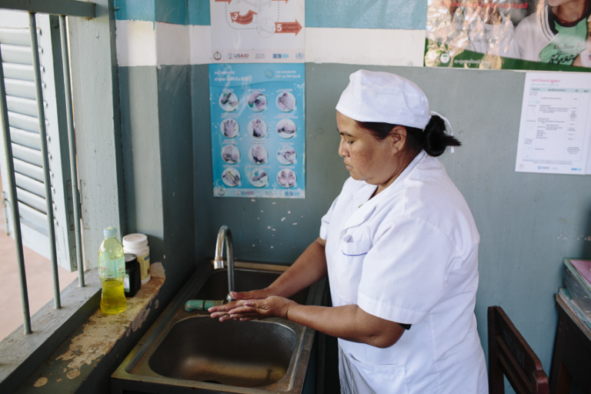
Prevention of anti-microbial resistance (AMR)
The Global Handwashing Partnership also used this year to build a targeted campaign to link hand hygiene and the prevention of antimicrobial resistance (AMR). With the high-level meeting on AMR held at the 2024 UN General Assembly, the Global Handwashing Partnership engaged partners to bring attention to the critical role of good hand hygiene in the prevention of AMR. Discussions were began to support future learning events and roundtables focused on this topic, and connections were made beyond the WASH sector to expand our audience. More work on this campaign will be continued in 2025, as the Global Handwashing Partnership identifies key opportunities for advocacy.
Photo Credit: WaterAid
12

Slide 13
Key Messages and Events
A key part of the Global Handwashing Partnership’s advocacy is developing key messages and identifying important moments throughout the year to disseminate those messages.
In 2024, the Global Handwashing Partnership shared key messages across various global advocacy events – including World Water Day, World Hand Hygiene Day, and World Antimicrobial Awareness Week – as well as key conferences and convenings.
hygiene in public restrooms. The event focused on the questions, “Why is advancing inclusive hygiene in public restrooms important? What barriers – invisible and visible – need to be eliminated so that all, regardless of conditions or abilities, concerns or stages of life, can pursue proper hygiene in the public restroom? And what change can we collectively enact?” The full event summary is available here.
UN General Assembly and High-Level Meeting on AMR
Roundtable: Inclusive Hygiene in Public Restrooms
Held on September 26, 2024, the second-ever high-level meeting on AMR served as the principal health-focused event during the 2024 UN General Assembly high-level week. This meeting was an important opportunity for world leaders to collectively address the looming threat AMR poses to global health, food security,
On June 25, 2024 in Washington, D.C., the Global Handwashing Partnership – alongside the Tork brand of Essity – brought together public and private sector voices for a thought-provoking roundtable discussion about inclusive
13
Notes:
Key messages and events
Tork roundtable
UNC Water and health Conferences
Stockholm World Water Week/UNGA
Developing key messages
HPE Webinar

Slide 14
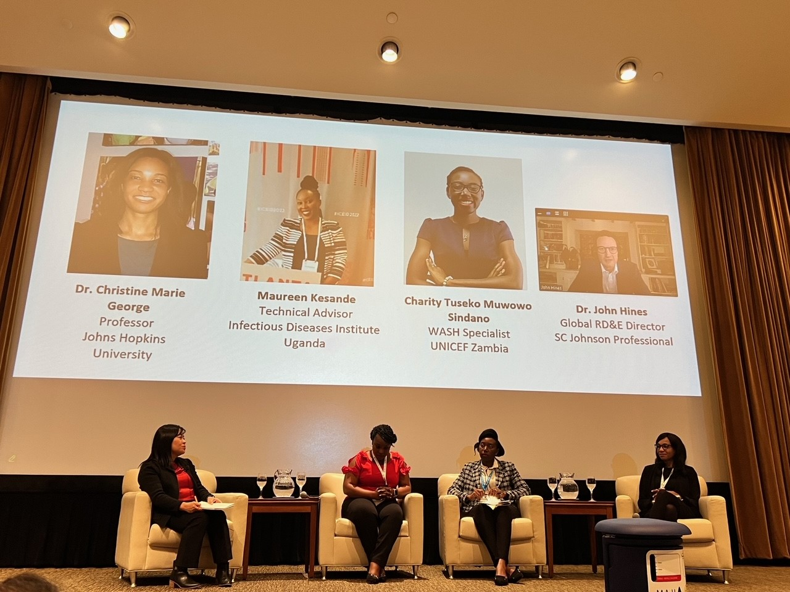
and achieving the 2030 Sustainable Development Goals. The Global Handwashing Partnership used this event as a key moment to build interest on the prevention of AMR, consolidating key messages and facilitating discussions in the lead up to the event.
On Global Handwashing Day, we hosted a spotlight session in the main auditorium, sharing updates from WHO on forthcoming guidelines for hand hygiene in community settings and elevating the issue of hand hygiene on a larger stage, engaging our partners to bring different perspectives for a thought-provoking discussion.
UNC Water & Health Conference
The UNC Water & Health Conference was held from October 14 – 18, 2024. With Global Handwashing Day aligned with the conference dates, the Global Handwashing Partnership used this conference as an opportunity to spotlight hand hygiene. The Global Handwashing Partnership convened three sessions at this year’s conference. In the first session, we supported the launch of a new technical guide for handwashing facilities in public spaces and institutions. In the second session, we supported new research on food hygiene and handwashing.
Photo Credit: Global Handwashing Partnership
14

Slide 15
Knowledge Management Highlights
“Just Ask the Global Handwashing Partnership”
“Just Ask the Global Handwashing Partnership,” is a microlearning initiative aimed at providing a centralized, short-form platform to increase hand hygiene capacity among hand hygiene professionals and practitioners.
Resource Hub
The Global Handwashing Partnership serves as a knowledge hub, maintaining a searchable resource hub on our website with the latest research and success stories for handwashing.
New Resources and Learning Events
As part of its commitment, the Global Handwashing Partnership not only amplifies existing resources through its resource hub but also creates new resources and facilitates learning events that fill knowledge gaps.
15

Slide 16
Just Ask the Global Handwashing Partnership
Recent global assessments indicate a clear gap in the knowledge, skills, and expertise needed to promote and implement hand hygiene interventions and initiatives. Evaluations have found a preference for resources that are short and more visual in nature to extend hand hygiene knowledge and understanding. The development of standardized materials, such as briefs and videos on key hand hygiene topics and best practices should be available to fill these gaps.
“Just Ask the Global Handwashing Partnership” is an upcoming initiative focused on using microlearning principles to build hand hygiene capacity. In 2024, the Global Handwashing Partnership Secretariat did initial preparation and planning for the initiative.
As part of their efforts, a series of end-user consultations with a range of global, regional and field representatives were conducted; a design charette to discuss platform navigation was completed; and initiated resources were drafted.
Once launched, this initiative will serve as a centralized platform for the Global Handwashing Partnership to provide condensed, actionable resources for numerous technical hand hygiene topics. Furthermore, this initiative will provide an opportunity for the Global Handwashing Partnership to voice its support for specific approaches, methods, and key messages for hand hygiene efforts and advocacy.
The initiative is set to launch in 2025.
16

Slide 17
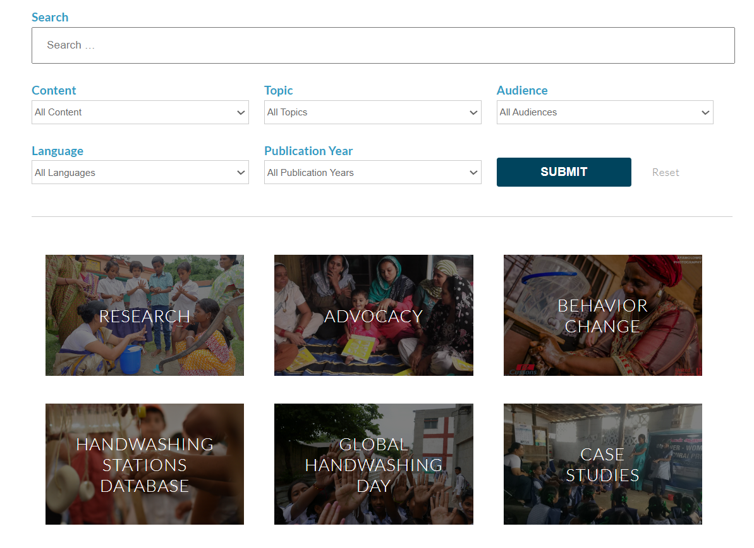
Resource Hub
The Global Handwashing Partnership maintains a resource hub on its website. This resource hub serves as a central repository of hand hygiene-related resources and is updated on a regular basis. Resources are tagged by content and topic.
In 2024, the Global Handwashing Partnership published 30 new resources to the resource hub, including the annual hand hygiene research summary, a technical guide for hand hygiene facilities, and several case studies and blogs on key hand hygiene topics. In total, the Global Handwashing Partnership website garnered more than 350,000 page views in 2024. Explore the Resource Hub here.
17

Slide 18
New Resources and Learning Events
As part of our knowledge management activities, the Global Handwashing Partnership not only amplifies partner resources but also develops new resources and facilitates learning events throughout the year.
hosted by the Global WASH Cluster. In this event, speakers shared examples of successful partnerships for hygiene behavior change, discussed innovatively designed behavior change interventions and their implementation at scale, and showcased practical experiences and results from country representatives.
Learning Event: Handwashing After the Pandemic
Resource: Hand Hygiene Research Summary
COVID-19 shined a light on the protective power of handwashing with soap. In times of crisis, people wash their hands more frequently and more thoroughly due to the increased perception of risk; however, handwashing rates have already begun to fall in this post-pandemic era. There is a need to identify and implement systemic actions that can continue to support and sustain behavior change at scale now at post-pandemic. The Global Handwashing Partnership convened this learning event in partnership with a broader speaker series
The Global Handwashing Partnership compiles and synthesizes peer-reviewed research from the previous year to create its annual hand hygiene research summary. The aim of this summary is to highlight key themes in hand hygiene research and identify potential needs for further research.
18

Slide 19
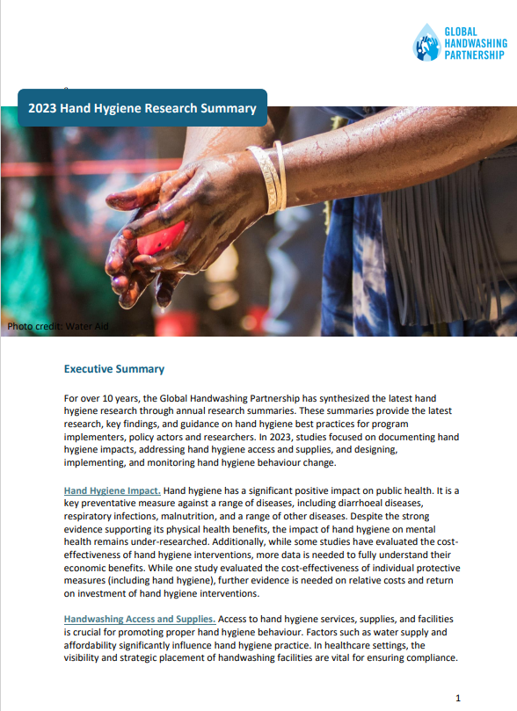
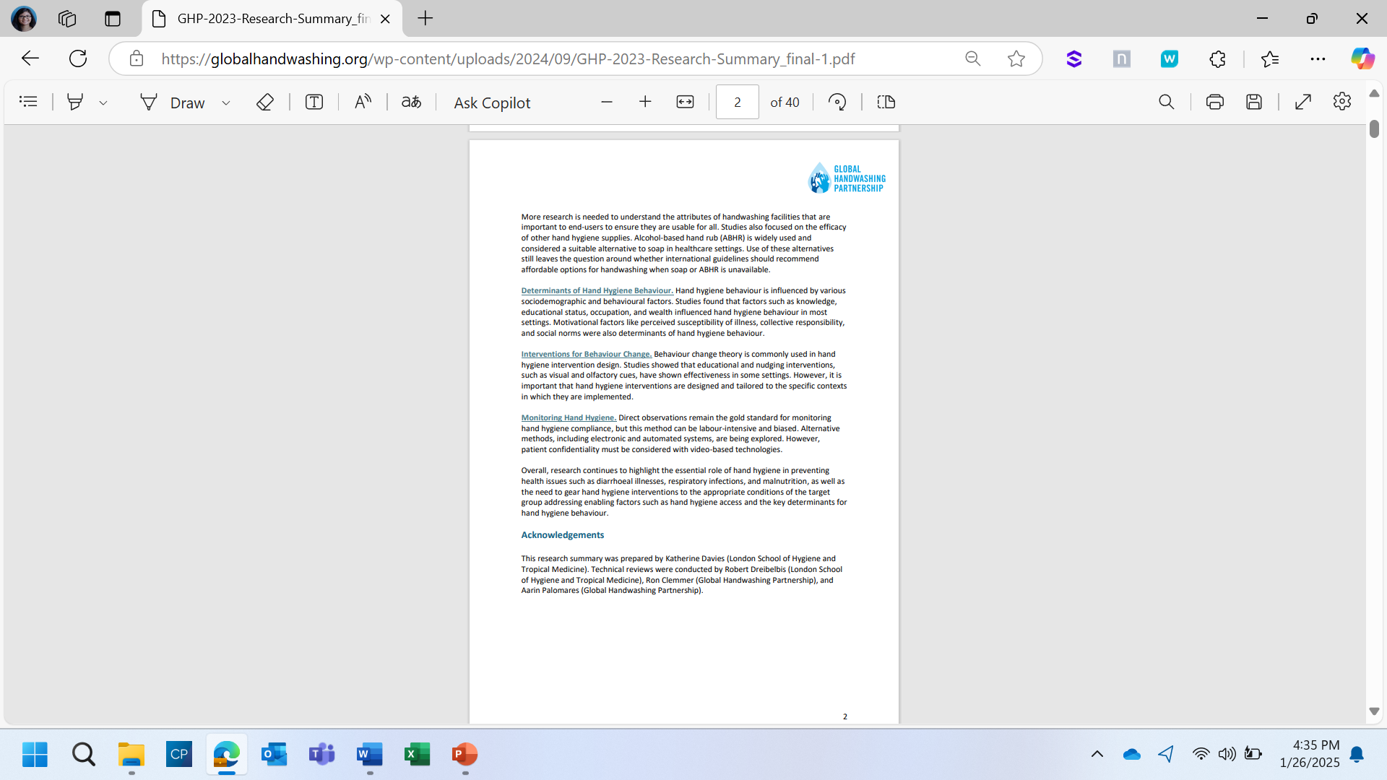
The 2023 Hand Hygiene Research Summary included the following sections:
Impact of Hand Hygiene
Handwashing Access and Supplies
Determinants of Hand Hygiene Behavior
Interventions for Hand Hygiene Behavior Change
Monitoring Hand Hygiene Behavior
The 2023 Hand Hygiene Research Summary was developed in collaboration with the London School of Hygiene and Tropical Medicine. View the full research summary here.
19

Slide 20
Coordination Highlights
Hand Hygiene for All Initiative
The Global Handwashing Partnership serves as a liaison between its partners and the Hand Hygiene for All Initiative. Led by WHO and UNICEF, the initiative seeks to mainstream hand hygiene as a public health intervention and works with national governments to develop national roadmaps for hand hygiene progress.
Partner Meetings
The Global Handwashing Partnership hosts quarterly partner meetings. These meetings serve not only as a space for networking but also as a space to dive into technical discussions among the partnership.
2025 – 2030 Strategy Development
The Global Handwashing Partnership updated its strategy for 2025 – 2030, reinvigorating its vision, mission, and overall impact.
20

Slide 21
Hand Hygiene for All Initiative
Since 2020, the Global Handwashing Partnership has served as a core partner of the Hand Hygiene for All Initiative (HH4A), which is led by UNICEF and WHO.
Created in response to COVID-19, the initiative serves as a catalyst for a coordinated push to improve national and global hand hygiene action. The initiative has made strong progress toward its vision catalyzing improved hand hygiene policies in 60+ countries, global research priorities identified, and coordination structures strengthening.
In 2024, the Global Handwashing Partnership supported key activities for the initiative, including continuing its leadership role for the
the initiative’s advocacy and communications working group and supporting the ongoing process for forthcoming guidelines on hand hygiene in community settings.
Hand Hygiene Advocacy and Communications Working Group
The Hand Hygiene Advocacy and Communications Working Group plays a critical role in advancing the hand hygiene agenda by galvanizing commitments and action across governments, private sector, and civil society. As the group lead, the Global Handwashing Partnership coordinates with HH4A core partners to share consistent hand hygiene messages throughout the year and deliver key outputs aligned with the initiative’s work plan.
21

Slide 22
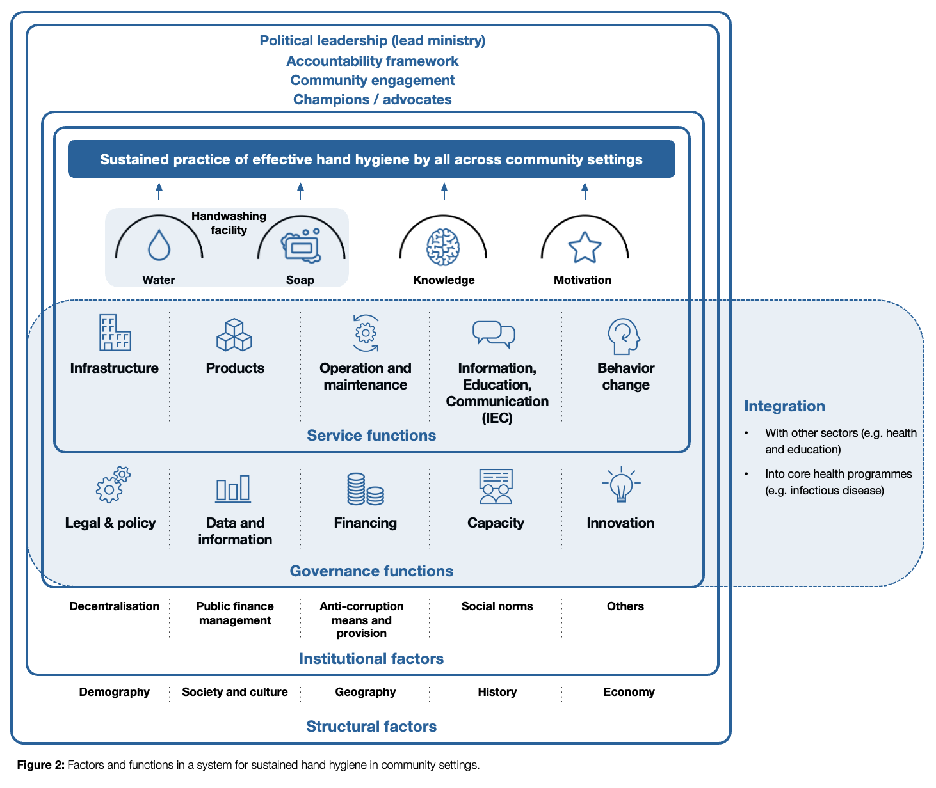
Global Guidelines on Hand Hygiene in Community Settings
in Kathmandu, Nepal. These workshops produced over 3,000 datapoints that were analyzed to develop a refined systems framework (see below) and implementation strategy that will be published along with the guidelines in 2025.
Historic neglect coupled with the recent surge in hand hygiene interest identified a need to develop normative guidelines for hand hygiene in community settings. Under its mandate to address demand for guidance on areas of public health, the WHO is leading the development of global guidelines in collaboration with UNICEF. These guidelines will provide evidence-based recommendations to governments on how to improve hand hygiene in community settings, focusing on rapid measures that can be implemented to address hand hygiene.
To support this process, the Global Handwashing Partnership supported the facilitation of several end-user consultations for the WHO/UNICEF global guidelines on hand hygiene in community settings, including national workshops among 10 champion countries and a global workshop hosted
Photo Credit: World Health Organization
22

Slide 23
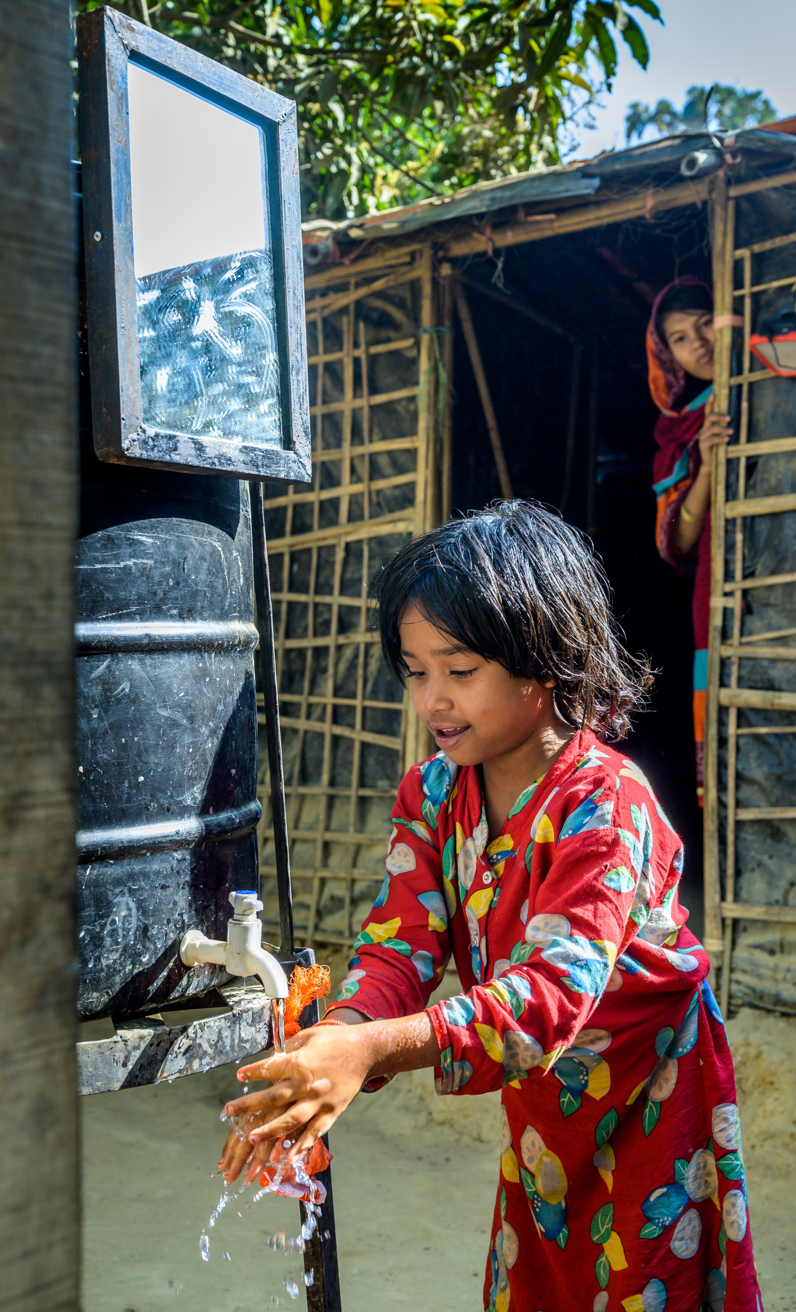
Partner Meetings
Partner meetings serve as a key component for overall partnership coordination. These meetings are designed to not only provide a space for partner networking but also to gather partner insights on key priorities.
In 2024, the Global Handwashing Partnership hosted quarterly partner meetings, each with a different thematic priority. Partner meeting topics were as follows:
April 2023: Input into the Just Ask the Global Handwashing Partnership
June 2023: Hand Hygiene and AMR
September 2023: Preparation for Global Handwashing Day
December 2023: Summary of Partnership activities in 2024 and discussion of 2025 priorities
23
Photo Credit: World Vision

Slide 24
2025 – 2030 Strategy Development
An important part of any initiative is reflecting and refining its strategic ambition to maximize its impact. This year, the Global Handwashing Partnership initiated an update to our strategy for 2025 – 2030, which will serve as an important guiding document as we prioritize our activities and fulfill our role in the lead up to 2030.
Through a consultant, the Global Handwashing Partnership conducted 17 key stakeholder interviews and 23 surveys to gather input, resulting in in nearly 700 datapoints to inform our updated strategy. Additional feedback sessions were hosted to get further feedback on the vision, mission and goals, with a draft strategy disseminated to core partners in December 2024. The updated vision and mission are available to the right. The final strategy is set to be approved by the Global Handwashing Partnership Steering Committee in 2025.
OUR VISION
All people benefit from clean hands
OUR MISSION
We drive change for clean hands and all its benefits.
24

Slide 25
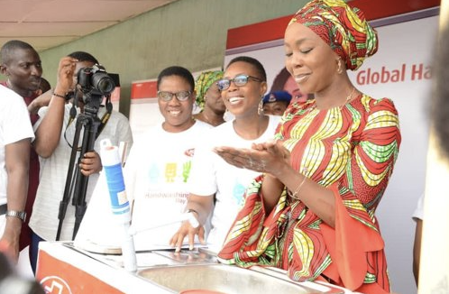
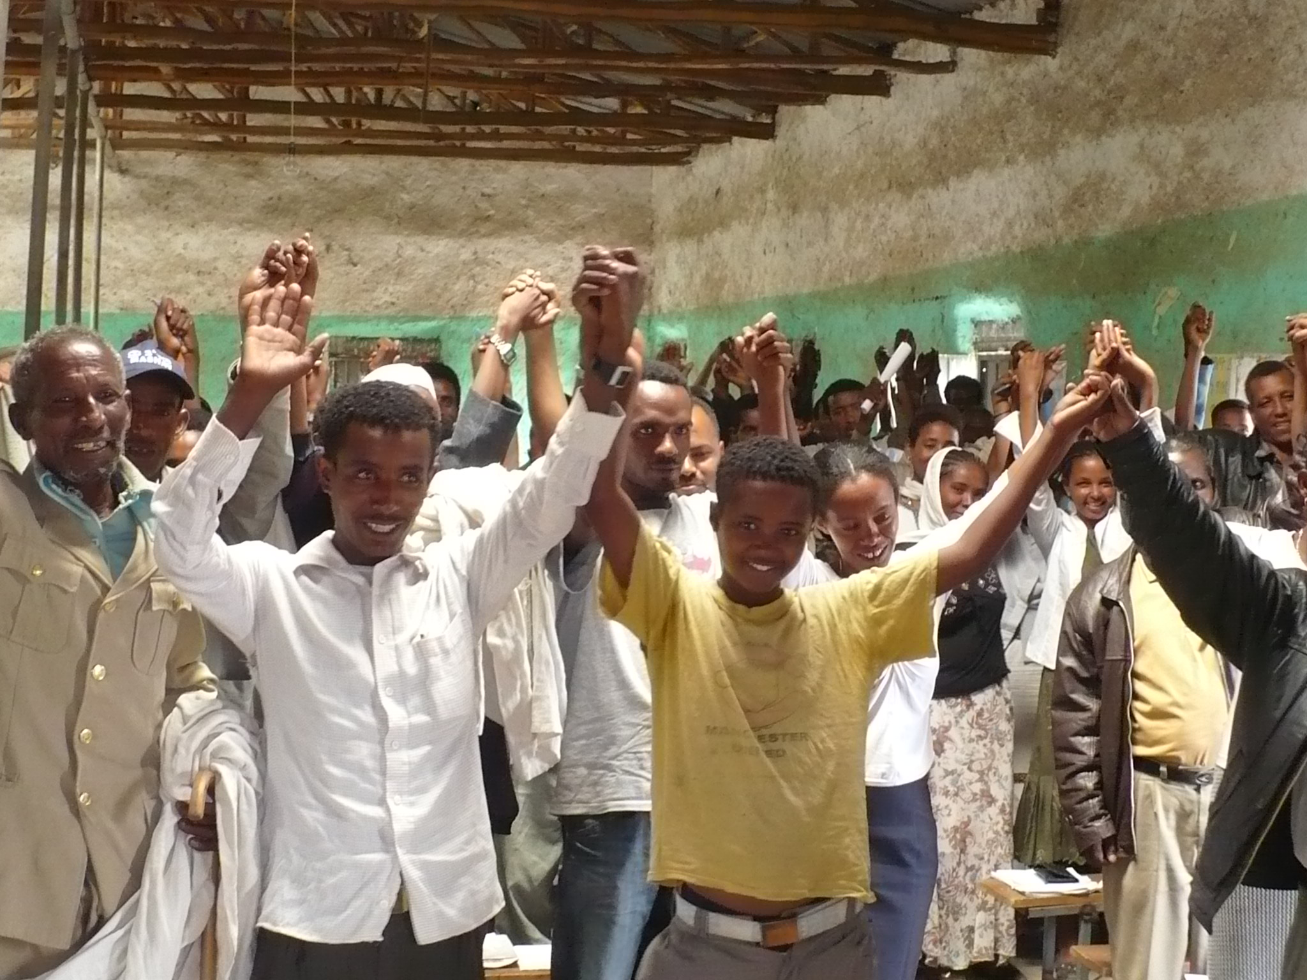
PARTNER SPOTLIGHTS
Photo Credit: FHI 360

Slide 26
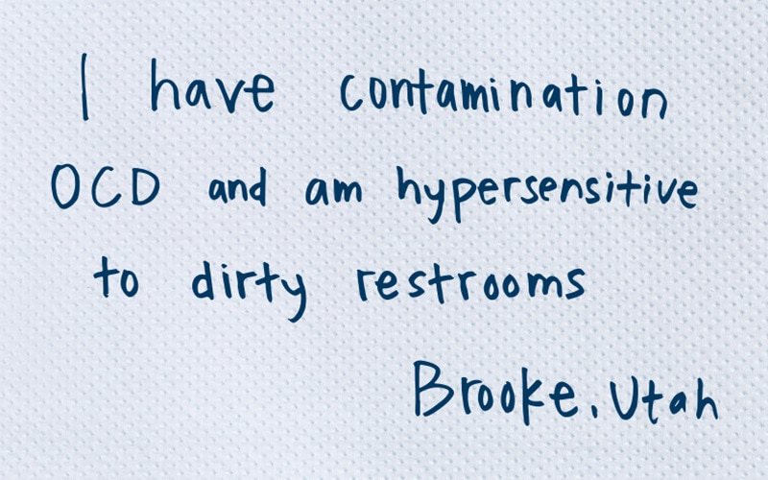
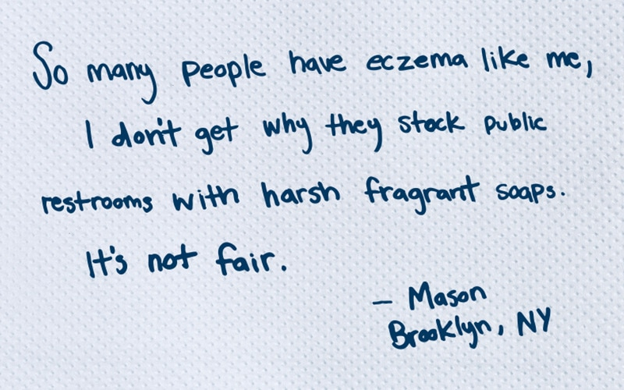
Essity
In 2024, Tork launched a global effort to advance inclusive hygiene in public restrooms in the United States.
Starting in March 2024, Tork launched this initiative through its “Paper Towel Plea.” The Paper Towel Plea captured personal experiences of people facing difficulties using public restrooms and printed them directly onto Tork paper towels that were available inside select restrooms. Not only did the paper towels contain powerful personal stories, but they also included a call to action and QR code that led people to an online experience with information on actions they could take to improve hand hygiene inclusivity. Furthermore, in June 2024, Tork partnered with the Global Handwashing Partnership to host a roundtable with key experts. More information for this event can be found on Page 13 of this report.
Learn more about this global effort here.
Photo Credit: Essity
26

Slide 27
FHI 360
FHI 360 hosts the Global Handwashing Partnership Secretariat and provides a leading role in the partnership’s overall coordination and activities. As secretariat host, FHI 360 leverages its organizational expertise to support not only the work of the Global Handwashing Partnership but also broader hand hygiene advocacy and knowledge management priorities.
This year, FHI 360 staff played a key role in Global Handwashing Partnership discussions. During one of the Global Handwashing Partnership’s quarterly partner meetings, Mungai Ndung‘u, FHI 360 Project Director for the Global Antimicrobial Resistance Laboratory and Response Network (GARLRN) project, presented his work and lessons learned. This presentation provided a case study on the importance of WASH and AMR prevention, a key priority for the Global Handwashing Partnership in the lead up to the high-level meeting on AMR (see Page 13 for more details).
The Global Handwashing Partnership also presented in several internal FHI 360 meetings, amplifying the work of the partnership to other FHI 360 colleagues. This includes discussions within FHI 360’s WASH Community of Practice.
Finally, the Global Handwashing Partnership and FHI 360 worked together to co-convene several external discussions and events, including at the 2024 UNC Water & Health Conference where they worked together on the Global Handwashing Partnership‘s spotlight session focused on elevating the importance of hand hygiene on Global Handwashing Day and the WASHPaLS #2 session focused on new research around handwashing and food hygiene. Both sessions were recorded and are available here and here. More details on both sessions can be found on Page 14 of this report. Overall, collaboration between FHI 360 and the Global Handwashing Partnership ensures optimized synergy to impact both organizational and partnership priorities.
27

Slide 28
Proctor & Gamble
Proctor & Gamble and its brands remain committed to handwashing education and access.
On Global Handwashing Day, Proctor & Gamble’s Safeguard brand collaborated with multiple brands in more than 20 cities and over 250 stores across China to disseminate hand hygiene messages. The campaign covered various contexts, including universities, parks, subways, shared bicycles, restaurants, supermarkets, and delivery lockers. Through its collective, Safeguard shared “Ten Scenarios for Scientific Handwashing,” sharing their research of handwashing to thousands of communities and homes.
Beyond Global Handwashing Day, Safeguard has run the "Spread Health Across China" public welfare project for five years. This project is dedicated to promoting hygiene knowledge and handwashing habits to 100 million people. This year, Safeguard continued its handwashing education initiative in elementary schools, teaching
children the scientific way to wash their hands. Through engaging demos and presentations, Safeguard helped students master the 7-step handwashing method, empowering them to become "Little Health Guardians."
Furthermore, Safeguard partnered with collaborators to directly donate liquid hand soap and educational books about handwashing to schools across the country. This handwashing education initiative has reached 9 cities in China, directly impacting over 1,200 students, and Safeguard has donated a total of 1,100 bottles of liquid hand soap so far.
Moving forward, Safeguard will continue to carry out school activities to help children in developing healthy habits.
28

Slide 29
WaterAid
For many years, WaterAid has worked with governments, UNICEF and other organizations to install handwashing facilities in a range of public places and buildings, including markets, transport hubs, public and communal toilets, healthcare facilities, schools, restaurants, places of worship, and commercial and public offices.
In the response to COVID-19, WaterAid designed the first technical guide for handwashing facilities in public places and buildings, which was published in August 2020 and available here. This guide provided guidance on existing best practices
for handwashing facilities and shared
innovation and learning from WaterAid’s
hygiene response to COVID-19 to date.
COVID-19 and other disease outbreaks accelerated the provision of handwashing facilities in public places, with the development of many hands-free innovations to meet the needs of the disease.
However, as the world moves beyond COVID-19, the emphasis is now on designing more long-term, sustainable public handwashing facilities.
This year, WaterAid worked with UNICEF to publish a revised version of the technical guide, which includes additional advice for installing
permanent and semi-permanent handwashing facilities; sharing designs, bills of quantities, construction notes; and guidance around management, operations and maintenance. The guide evaluates each technology’s advantages and disadvantages to support informed decision making and includes safety and accessibility checklists to make facilities more inclusive. Finally, there are monitoring checklists to ensure facilities are operated and maintained well.
The second edition of the technical guide is available here.
29

Slide 30
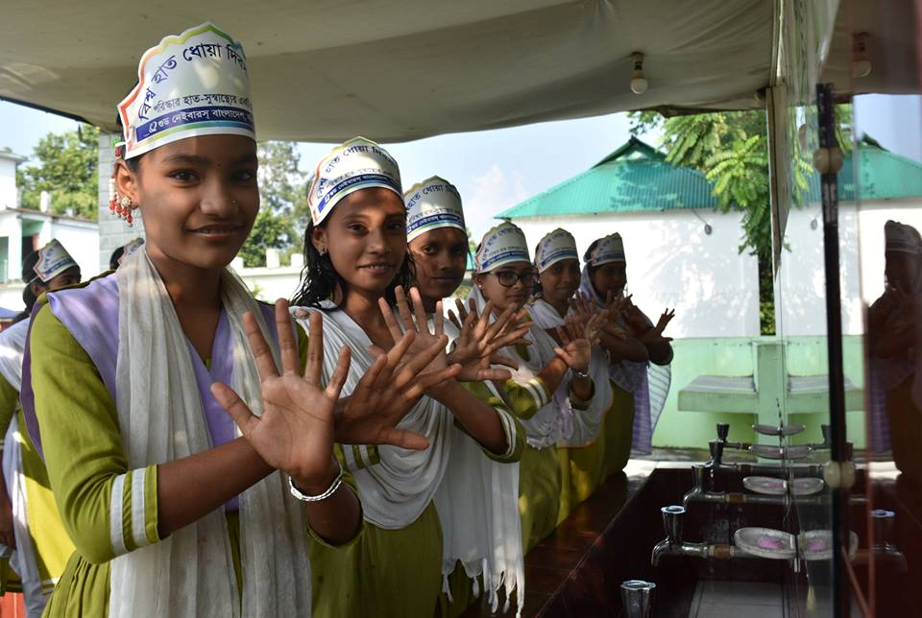
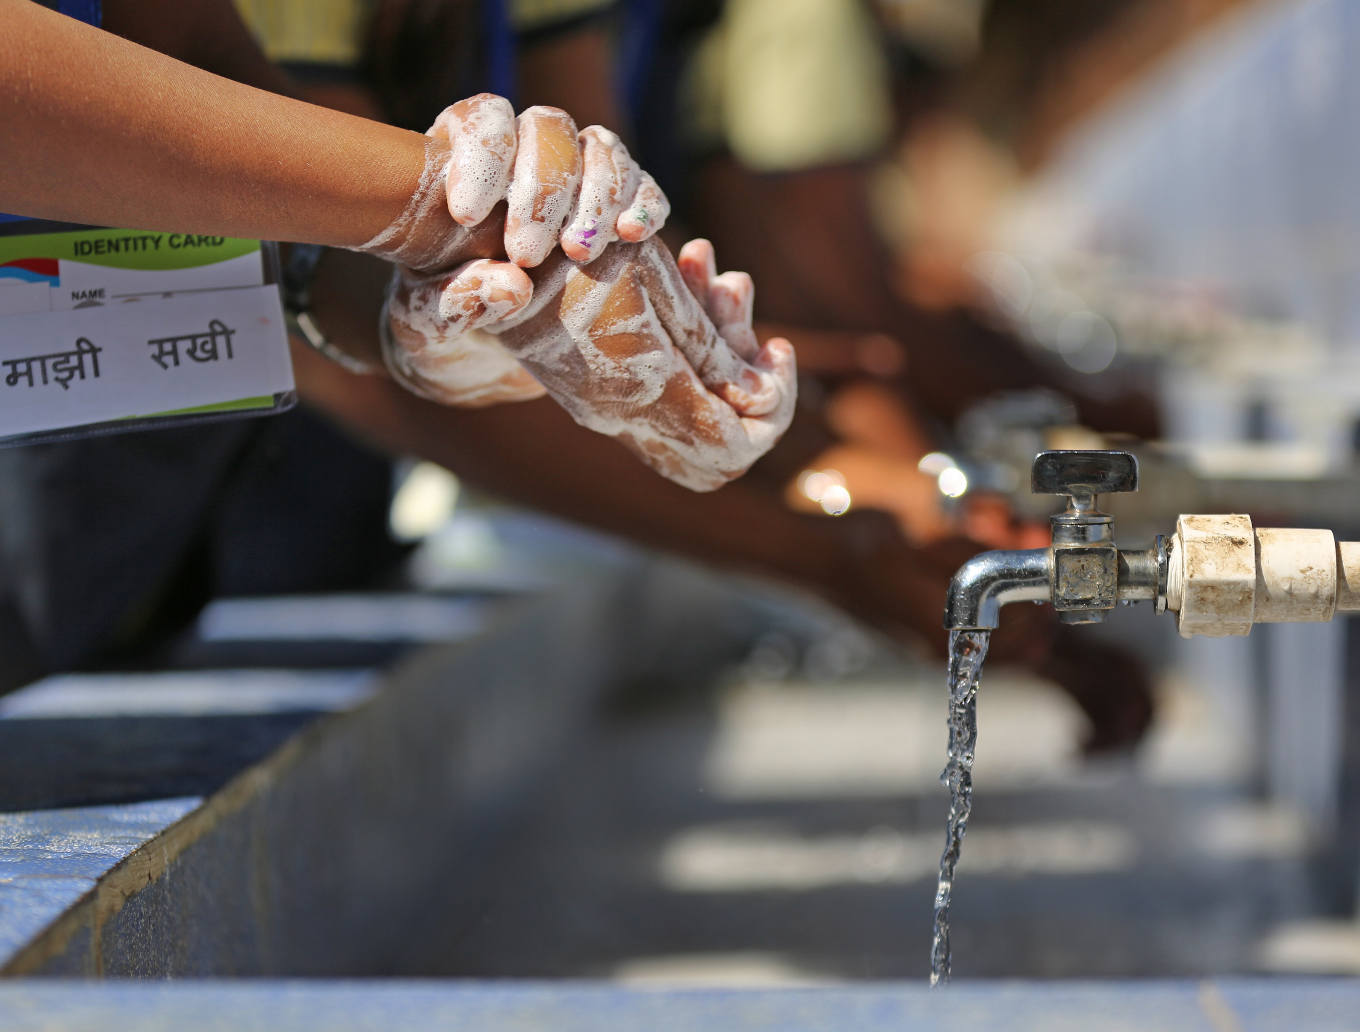
WAY FORWARD
Photo Credit: WaterAid

Slide 31
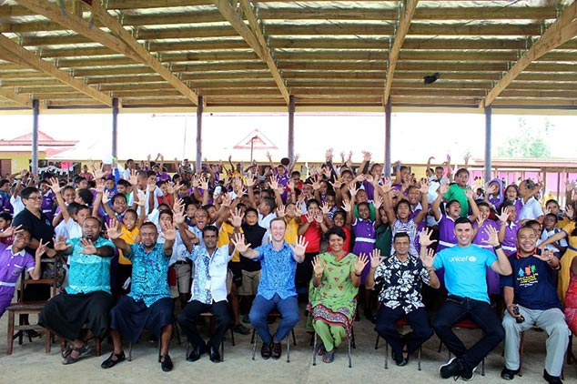
A Collective Way Forward
This year reminds us of how much progress has been made, from the development of practical hand hygiene resources to more integrated hand hygiene efforts to forthcoming guidelines for hand hygiene in community settings. These successes serve as a reminder of the many strides made toward ensuring universal hand hygiene, but we know there is still more work to do.
The Global Handwashing Partnership will continue our commitment to serve as a prominent global actor for hand hygiene advocacy and serve as a knowledge hub for hand hygiene actors around the world. Beyond these roles, the strength of the Global Handwashing Partnership has always been with our collective network. As we work toward a joint vision of hand hygiene for all, we must recognize and leverage the power of the whole of society.
To learn more about the partnership’s activities and priorities, visit the Global Handwashing Partnership website. To learn how to get involved, please e-mail our team at
contact@globalhandwashing.org.
Photo Credit: UNICEF
31

Slide 32
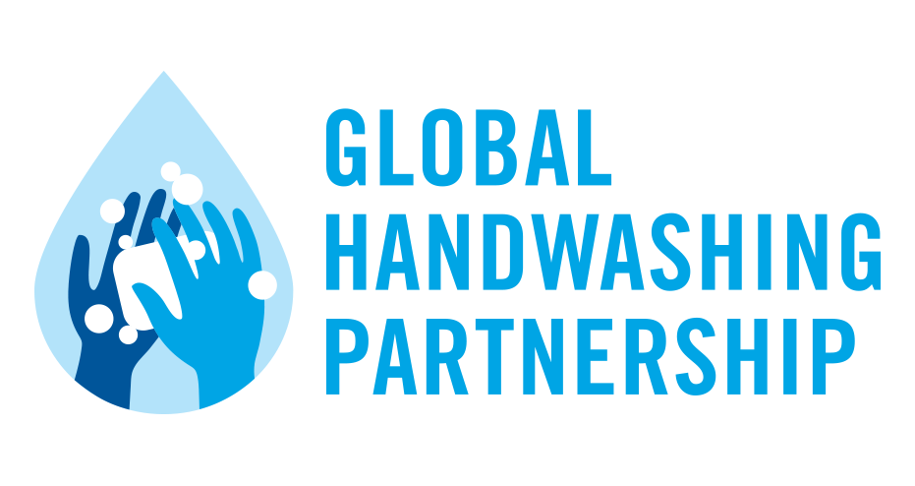







Steering Committee and Strategic Partners
Members
Affiliates
Action Against Hunger
Banka Bioloo
CAWST
Clean the World Foundation
DefeatDD
DevWorks International
EcoSoap Bank
Gobie Clean
Handzies
HappyTap
IAPMO
Icddr,b
International Aid
IRC WASH
Manila Water Foundation
Medentech
MSR Global Health
PHAAE
Real Relief
S3 Global
Soapbox Collaborative
Smixin
Soapen
SPATAP
Splash
Tearfund
Unilever
United Purpose
Vaccine Ambassadors
Wellbeing Foundation
World Vision

Slide 33
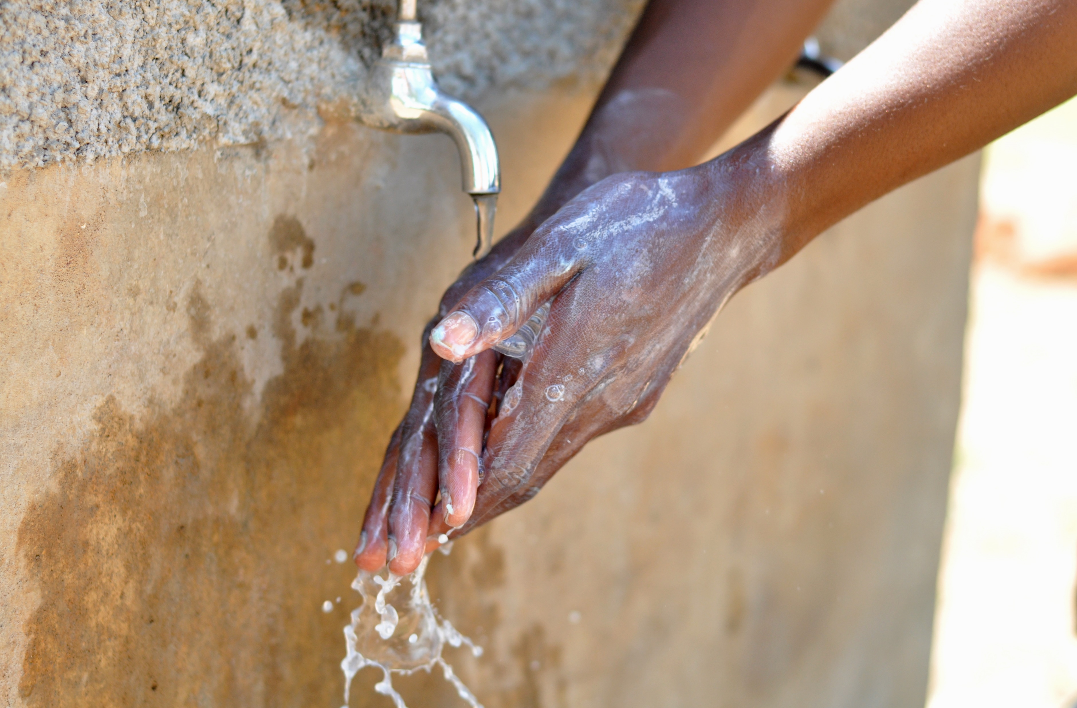
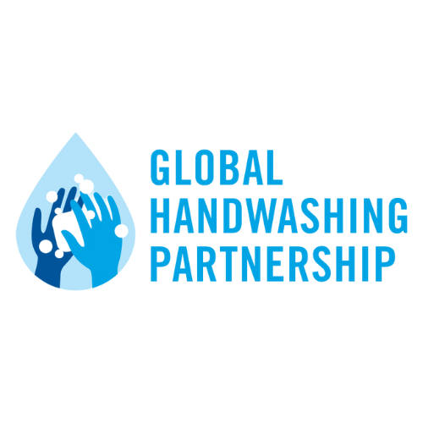
2024

