Slide 1
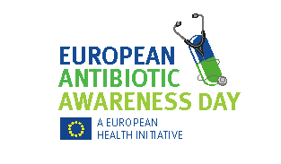
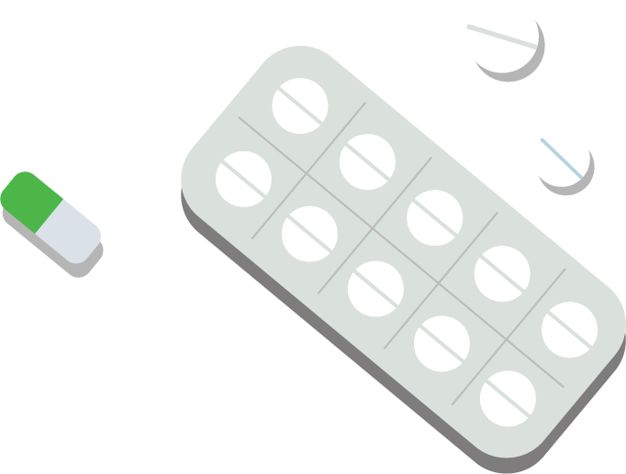



Use antibiotics responsibly!
Always take antibiotics only when and as prescribed by a doctor and for the entire prescribed duration.
Self-medicating or sharing antibiotics can increase resistance of bacteria to antibiotics.

Slide 2
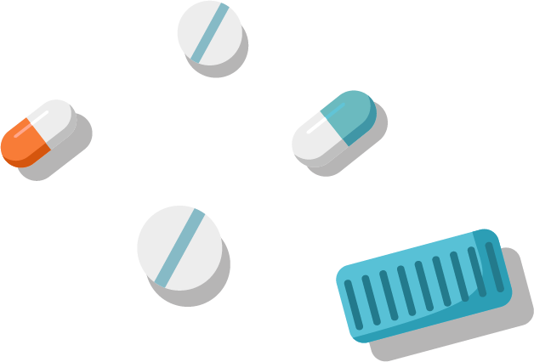
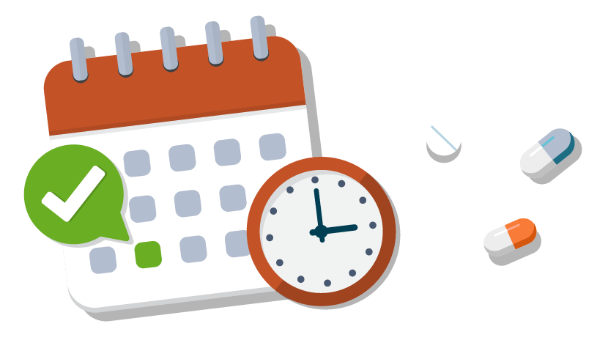
Always finish your full course of antibiotics, as prescribed by your doctor, even if you feel better after only a few days of antibiotics.
Stopping the treatment too soon can allow bacteria to survive and develop resistance to antibiotics.

Slide 3
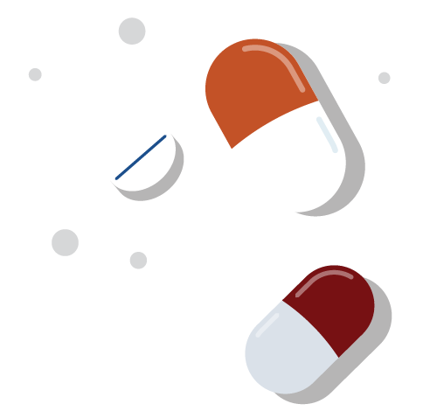
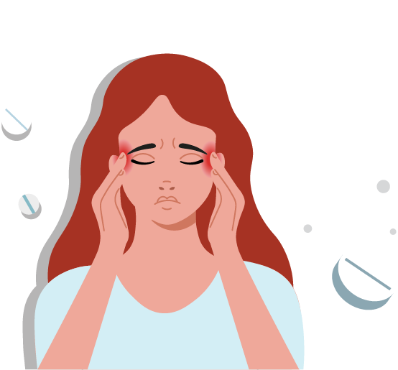
Antibiotics are not painkillers!
They only work against bacterial infections, not against viruses like common cold, flu or COVID-19.
Antibiotics will not help with aches or fevers.

Slide 4
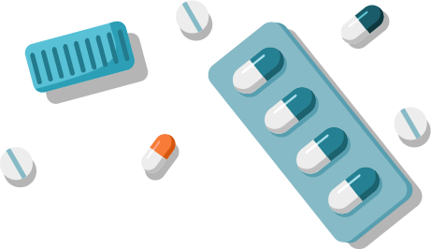
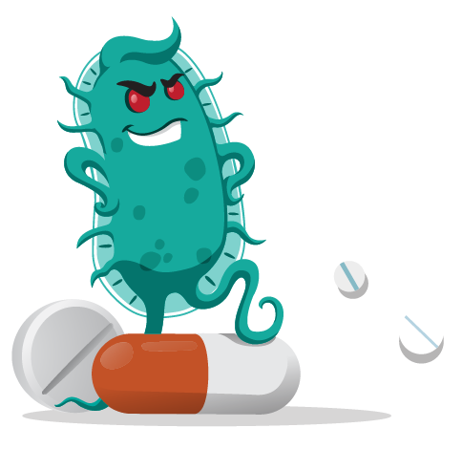
Taking antibiotics for the wrong reason will not make you feel better faster but can increase resistance of bacteria to antibiotics.
If you are not sure, consult your doctor.

Slide 5


Bacteria, not humans can become resistant to antibiotics.
Even healthy people or those who rarely take antibiotics can suffer complications if they get infected with antibiotic-resistant bacteria.
Resistant bacteria can spread from person to person, making infections more difficult to treat.

Slide 6


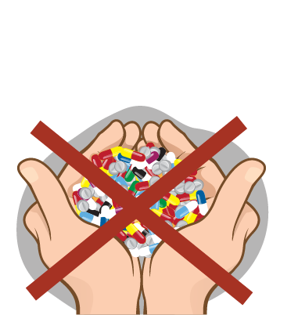

Never keep or use leftover antibiotics! Self-medication can make you choose the wrong antibiotic, use an insufficient dosage or even take antibiotics when they are not necessary.
This can also increase resistance of bacteria to antibiotics.

Slide 7
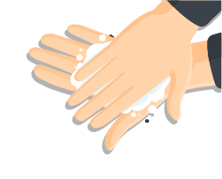

Many infections in healthcare facilities and in the community can be prevented through proper hand hygiene.
Wash your hands frequently with soap and water or clean your hands regularly with alcohol-based solutions!

Slide 8
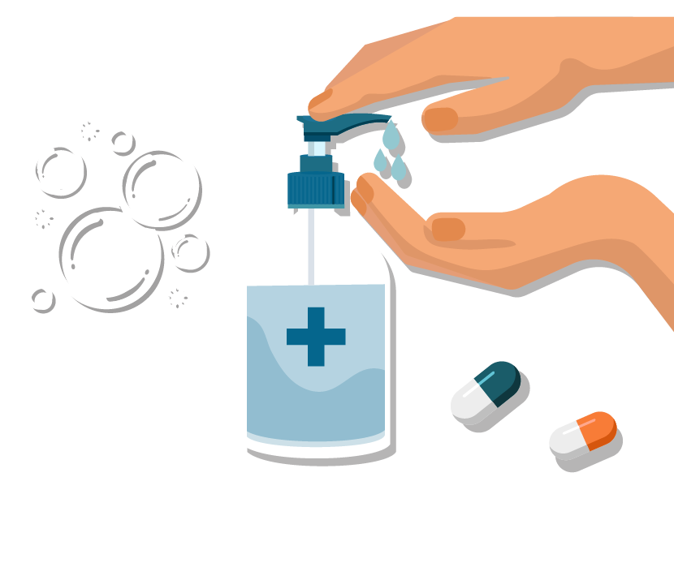
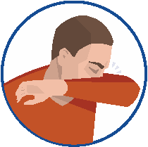


Vaccines, respiratory etiquette and proper hand hygiene contribute to fewer infections, less antibiotic prescriptions and less antibiotic-resistant
bacteria.

