Slide 1
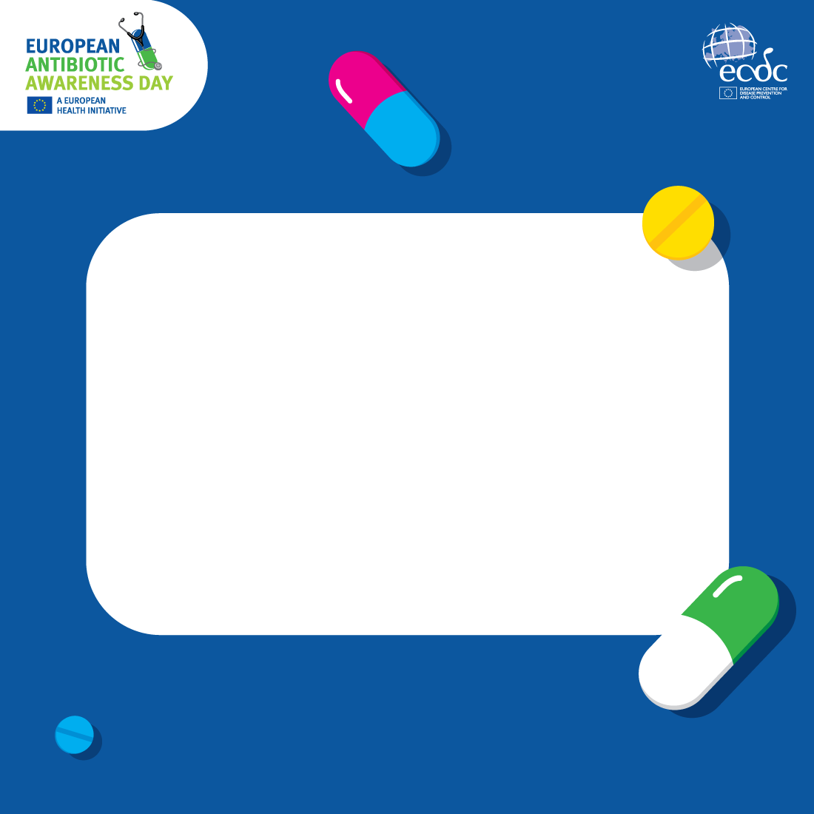
Antimicrobial resistance (AMR) leads to:
  antibiotics and other antimicrobials becoming less effective
  infections being increasingly difficult or impossible to treat.
For patients, this results in prolonged illness and sometimes death.
Learn more about AMR, its impact on the
human health and what can be done to fight it!

Slide 2
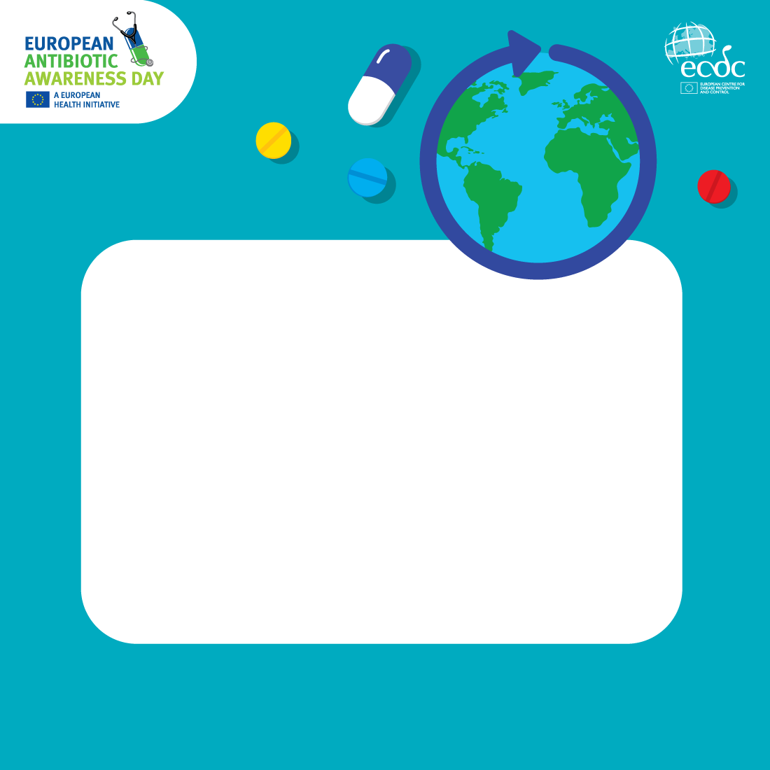
Antimicrobial resistance
(AMR) is a global health threat.
How did we get here?
  Inappropriate and excessive use of antibiotics and other antimicrobials in humans, animals and agriculture.
  Poor infection prevention and control (IPC) practices in healthcare settings.
Learn more about AMR, its impact on the
human health and what can be done to fight it!

Slide 3
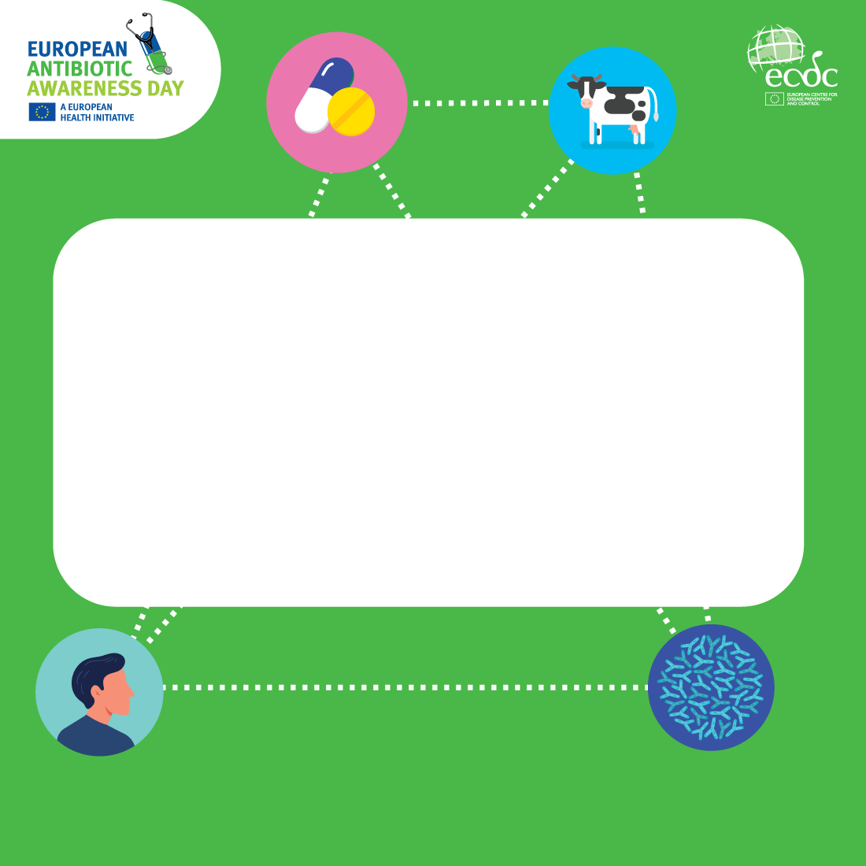
Antimicrobial resistance (AMR) threatens humans, animals and the environment, as bacteria and other microorganisms can spread within and between all sectors.
This is why AMR requires integrated interventions from multiple sectors, known as the One Health approach.
Learn more about AMR, its impact on the
human health and what can be done to fight it!

Slide 4
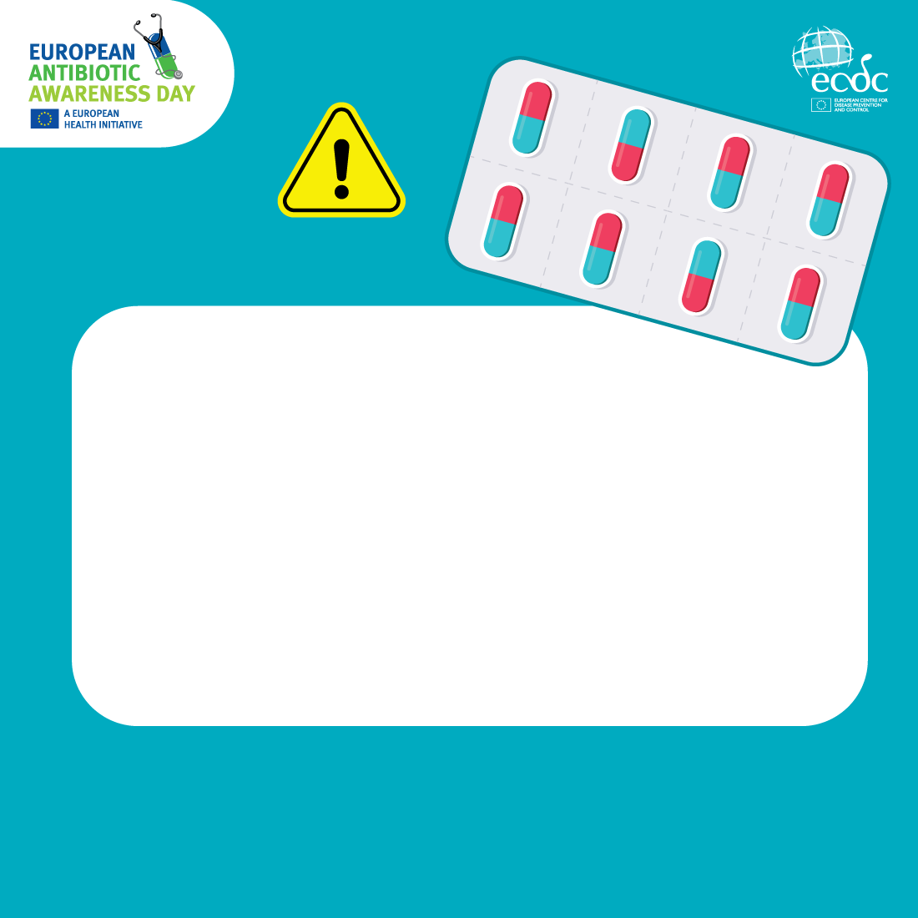
Urgent actions need to be taken
to address antimicrobial resistance (AMR) to avoid:
  prolonged or untreatable infections,
  increased death rates,
  increased burden on healthcare systems,
  increased economic burden.
Learn more about AMR, its impact on the
human health and what can be done to fight it!

Slide 5
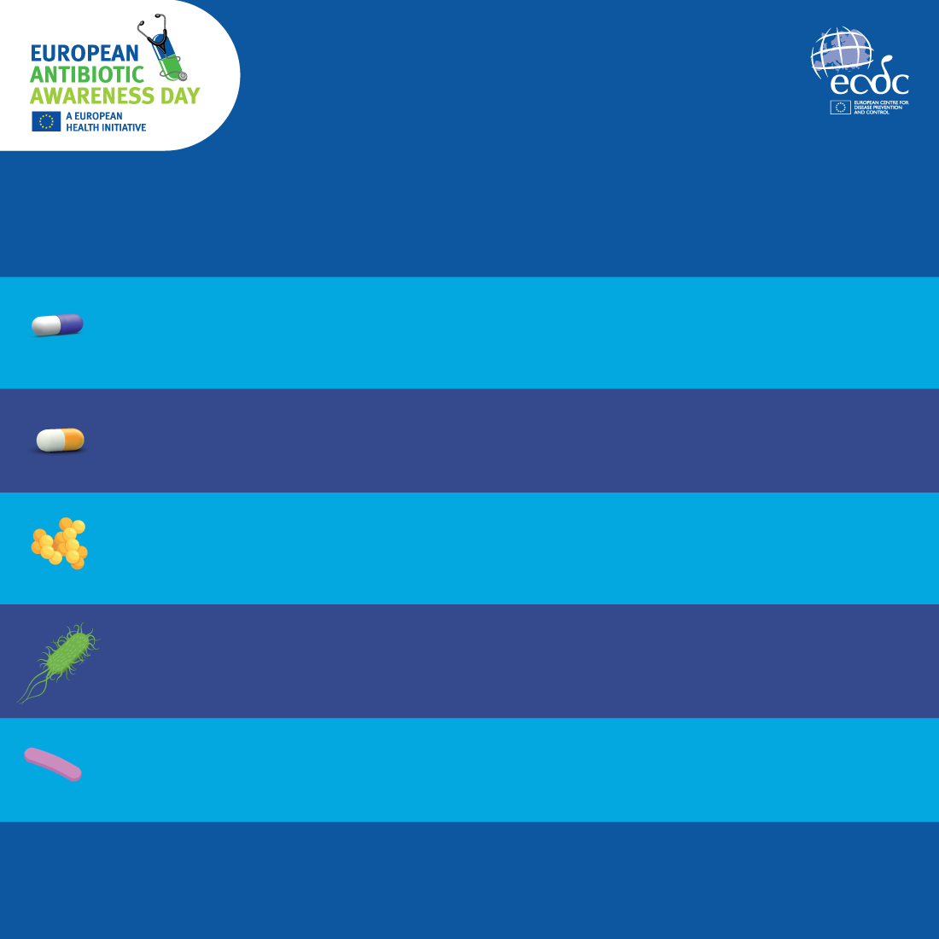
EU ANTIMICROBIAL RESISTANCE
(AMR) TARGETS BY 2030:
Reduce by 20% the total consumption of antibiotics
in humans.
At least 65% of the total consumption of antibiotics
in humans belongs to the ‘Access’ group of antibiotics.
Reduce by 15% the total incidence of bloodstream infections
with meticillin-resistant MRSA Staphylococcus aureus.
Reduce by 10% the total incidence of bloodstream infections with third-generations cephalosporin-resistant Escherichia coli.
Reduce by 5% the total incidence of bloodstream infections
with carbapenem-resistant Klebsiella pneumoniae.
There are recommended AMR targets for each EU Member State. Find out how your country is doing!

Slide 6
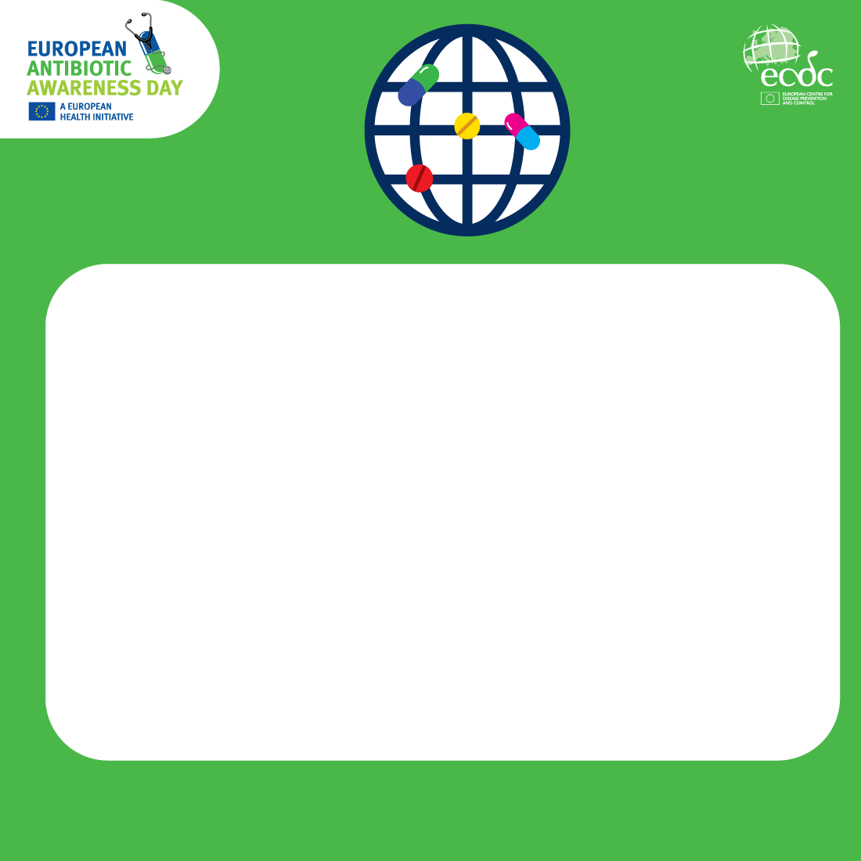
Antimicrobial resistance (AMR) is a global public health threat. To fight AMR, countries must:
  Ensure measures to support the prudent use of antimicrobials in healthcare settings, long-term care facilities, and community
  Strengthen infection prevention and control (IPC) in healthcare settings and long-term care facilities
  Promote IPC measures and policies in communities
  Promote the development of and accessibility to novel antimicrobials and alternatives to antimicrobials.
Learn more about AMR, its impact on the
human health and what can be done to fight it!

Slide 7
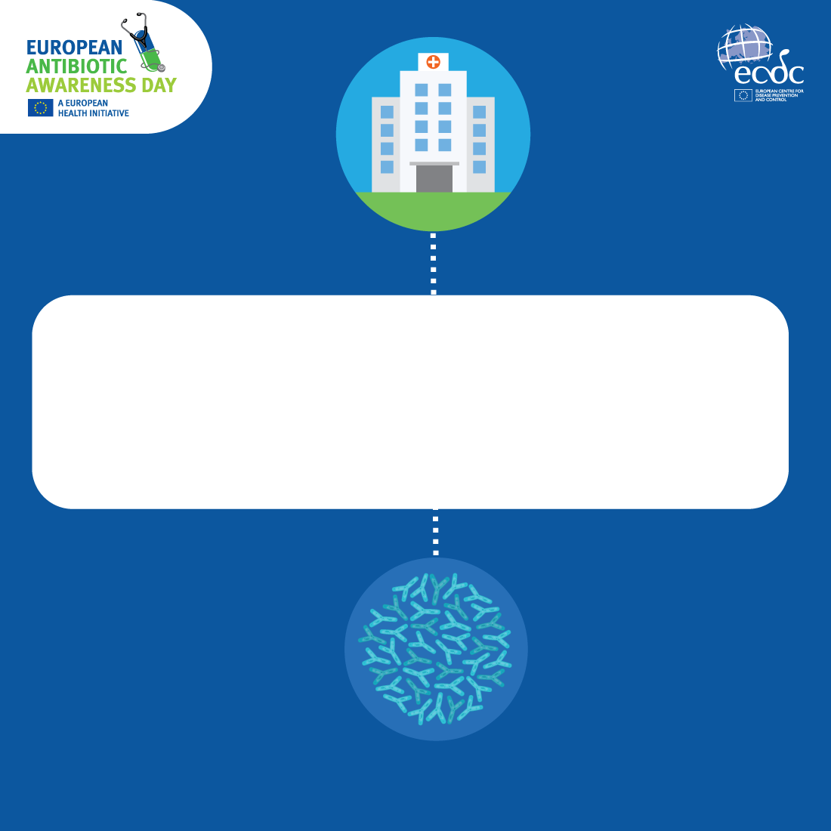
In hospitals alone, healthcare-associated infections cause more deaths in Europe than any other infectious disease under surveillance at ECDC.
Learn more about how infection prevention and control practices in healthcare settings can reduce the number of healthcare-associated infections!

Slide 8
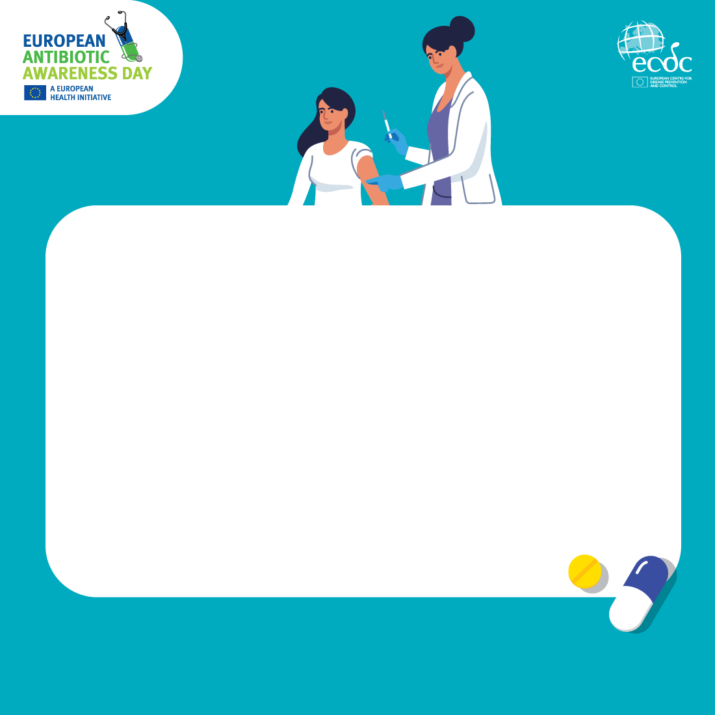
Vaccines play an important role in the fight against antimicrobial resistance (AMR).
By stopping the spread of infections, they help to reduce the number of antibiotic prescriptions - meaning bacteria develop less resistance to antibiotics.
Help keep our antibiotics working by
making sure that you and your family are
up to date on your vaccinations!
Learn more about the benefits of vaccination on: vaccination-info.europa.eu
Learn more about AMR and how to fight it.

