Slide 1
Praktiline koolitus põllumeestele ja loomaarstidele:
Rühmaharjutused
Eesti, 2024-03-10/11
Notes:
The second part of the hands-on-training focuses on the idea of “Prevention is better than cure”. Farmers and veterinarians will work together exploring changes at farm level as preventive measures to reduce the need of reducing antimicrobial use. These implies that a common understanding between farmers and veterinarians is needed.
The second part of the hands-on-training focuses on the idea of “Prevention is better than cure”. Farmers and veterinarians will work together exploring changes at farm level as preventive measures to reduce the need of reducing antimicrobial use. These implies that a common understanding between farmers and veterinarians is needed.

Slide 2
„Ennetamine on parem kui ravimine“
I osa
Ülemaailmne vajadus: mikroobivastase resistentsuse vähendamine
Uus reguleeriv raamistik
Ennetavad meetmed tuleb rakendada põllumajandusettevõtte tasandil
II osa
Muudatused farmi tasandil: ühine arusaam põllumajandustootjate
ja loomaarstide vahel

Slide 3



„Ennetamine on parem kui ravimine“
Tehkem koostööd, et ennetada ja vähendada mikroobivastaste ainete kasutamist…
Tegevuspunktide loomisega TEIE (kliendi) farmis
Notes:
“Let’s work together to prevent and reduce the use of antimicrobial”. “Let’s work together to prevent and reduce the use of antimicrobial”.

Slide 4
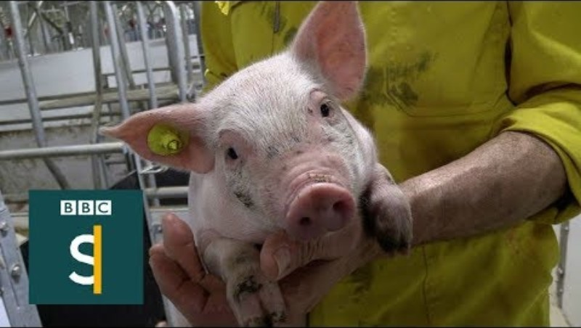
WHY?
Notes:
-If unable to open de video, open video in Youtube:
https://www.youtube.com/watch?v=jFuQqwBmN8A
-Activate subtitles in English
-If unable to open de video, open video in Youtube:
https://www.youtube.com/watch?v=jFuQqwBmN8A
-Activate subtitles in English

Slide 5
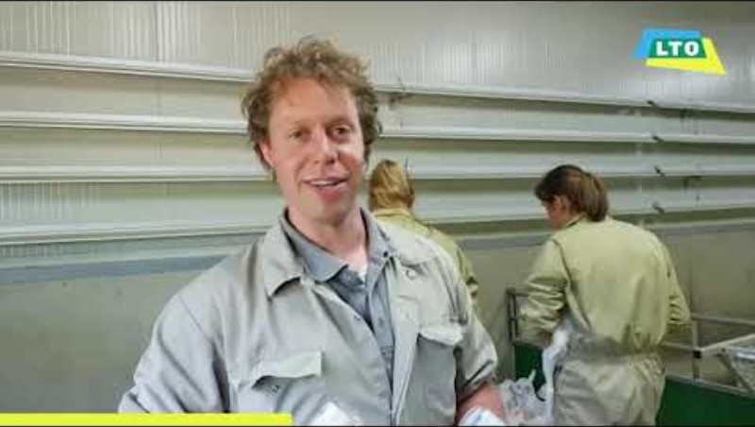
Koostöö edendamine põllumajandustootjate ja loomaarstide vahel
Põllumajandustootja ja loomaarst teevad üha enam koostööd loomade tervise parandamiseks ja mikroobivastaste ainete kasutamise vähendamiseks farmi tasandil… Sest see on tõhus!
Tänase päeva eesmärk on tuvastada ühised võtmevaldkonnad,
milles põllumajandustootjad ja loomaarstid saavad koostööd teha,
mis viib edasise paranemiseni.
Notes:
-If unable to open de video, open video in Youtube:
https://www.youtube.com/watch?v=cu7cIIlbOd8
-Activate subtitles in English
Rational: A strong and well-established relationship between farmers and veterinarians forms the cornerstone for implementing effective measures at farm level to prevent and reduce the use of antimicrobials. It is therefore crucial to identify common key areas in which they can collaborate to foster trust between veterinarians and farmers. When both groups are able to identify the problems and solutions, this will set a strong basis for improvement.
-If unable to open de video, open video in Youtube:
https://www.youtube.com/watch?v=cu7cIIlbOd8
-Activate subtitles in English
Rational: A strong and well-established relationship between farmers and veterinarians forms the cornerstone for implementing effective measures at farm level to prevent and reduce the use of antimicrobials. It is therefore crucial to identify common key areas in which they can collaborate to foster trust between veterinarians and farmers. When both groups are able to identify the problems and solutions, this will set a strong basis for improvement.

Slide 6
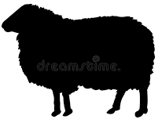








Teeme järgmisi rühmaharjutusi:
GE 1
Takistused parimate tavade rakendamisel?
Rühmatreening 1
Tuvastage takistused parimate tavade rakendamiseks
kasvatamise tavad
vähendada ja kasutada vastutustundlikult mikroobivastaseid aineid
Põllumeeste takistused tuvastatud
Loomaarstide takistused tuvastatud
Rühmatreening 2
Otsige lahendusi
2 a
2 b
kasvatustavade parendamiseks
takistuste vähendamiseks, et vähendada
ja vastutustundlikult kasutada mikroobivastaseid aineid
GE 2a
Konkreetne
Mõõdetav
Saavutatav
Realistlik
Õigeaegne
Tuvastage
EE
SM
ÄR
GI
D
GE 2b
Mida
te tahate
teha?
Kuidas te teate, millal$’$olete selleni jõudnud?
Kas on teie võimuses seda täita?
Kas saate seda reaalselt saavutada?
Millal täpselt soovite seda täita?
Rühmatreening 3
Jagamine, tulemuste esitamine
3 a
3 b
GE 3a
Nimekiri kasvatustavadest
Meetmed, et vähendada ja vastutustundlikult kasutada mikroobivastaseid aineid
GE 3b
Notes:
The activity will consist in agreeing action points at farm level, measures that are personally valuable to both farmers and veterinarians.
In other countries: Farmers and veterinarians in separate groups
The aim of the exercise is to identify different challenges and opportunities observed in the field that impact the implementation of best practices and further reduction of AMU, such as husbandry conditions, disease situation, biosecurity, animal health visits, diagnostic testing, prescription and use of antimicrobials, etc. The findings of this GE1 will serve as a basis for GE2a and GE2b. The activity will consist in agreeing action points at farm level, measures that are personally valuable to both farmers and veterinarians.
In other countries: Farmers and veterinarians in separate groups
The aim of the exercise is to identify different challenges and opportunities observed in the field that impact the implementation of best practices and further reduction of AMU, such as husbandry conditions, disease situation, biosecurity, animal health visits, diagnostic testing, prescription and use of antimicrobials, etc. The findings of this GE1 will serve as a basis for GE2a and GE2b.

Slide 7
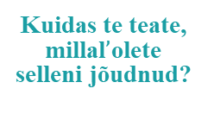
Teadaanne
Pärast rühmaharjutusi 2a ja 2b palutakse teil üles kirjutada SMART-i tegevuspunkt iseenda jaoks – mida rakendada teie / teie kliendi farmis
Konkreetne
Mõõdetav
Saavutatav
Realistlik
Õigeaegne
EE
SM
ÄR
GI
D
Mida
te tahate
teha?
Kuidas te teate, millal$’$olete selleni jõudnud?
Kas on teie võimuses seda täita?
Kas saate seda reaalselt saavutada?
Millal täpselt soovite seda täita?
Näiteks:
Analüüsides vere- ja tapaliini testi tulemusi ning kohandades vastavalt vaktsineerimispoliitikat, ei teki 2 kuu jooksul võõrutavatel põrsastel köha.

Slide 8
Group exercise 1
Identify the barriers for the
implementation of best practices
45
MIN
…to further reduce the need to use antimicrobials
Groups divided per specie:
Malta
You can go to your table number!
Group 1
Bovine
Group 2
Poultry & aquaculture
Group 3
Poultry
Group 4
Small ruminants 1
Group 5
Small ruminants 2
Group 6
Swine
Notes:
Note for Malta: groups will be mixed of farmers and veterinarians, considering the reduced number of veterinarians.
In other countries, groups will be separated.
For the group facilitators in Malta: give farmers 1 colour of post-its, and vets another colour. Ask in the last 10 minutes to the farmers (and the vets) to ‘change hats’: will they answer the questions differently? Now, give to the farmers the post-it colours of the vets, and to the vets the post-it colours of the farmers.
The aim of the exercise is to identify different challenges and opportunities observed in the field that impact the implementation of best practices and further reduction of AMU, such as husbandry conditions, disease situation, biosecurity, animal health visits, diagnostic testing, prescription and use of antimicrobials, etc. The findings of this GE1 will serve as a basis for GE2a and GE2b.
(small ruminants – poultry – swine – bovine)
Small ruminants group will be subdivided into 2 groups
Other participants of species (rabbits, land animals, aquaculture) are placed into the groups where they can most relate to
Note for Malta: groups will be mixed of farmers and veterinarians, considering the reduced number of veterinarians.
In other countries, groups will be separated.
For the group facilitators in Malta: give farmers 1 colour of post-its, and vets another colour. Ask in the last 10 minutes to the farmers (and the vets) to ‘change hats’: will they answer the questions differently? Now, give to the farmers the post-it colours of the vets, and to the vets the post-it colours of the farmers.
The aim of the exercise is to identify different challenges and opportunities observed in the field that impact the implementation of best practices and further reduction of AMU, such as husbandry conditions, disease situation, biosecurity, animal health visits, diagnostic testing, prescription and use of antimicrobials, etc. The findings of this GE1 will serve as a basis for GE2a and GE2b.
(small ruminants – poultry – swine – bovine)
Small ruminants group will be subdivided into 2 groups
Other participants of species (rabbits, land animals, aquaculture) are placed into the groups where they can most relate to

Slide 9
Rühmatreening 1
Tehke kindlaks takistused
parimate tavade rakendamiseks
45
MIN
Palun vastake järgmistele küsimustele:
  Milliseid mikroobivastaseid aineid kasutatakse teie liigil enim ja millistel tingimustel?
  Millised on takistused AMU vähendamiseks
  nendes tingimustes?
  Jaotage takistused 3 kategooriasse (üks takistuse tüüp lehel)
      Kasvatamise tavad
      Antibiootikumide kasutamise vähendamine ja vastutustundlik kasutamine
      Muu
Töötage kleebikutega, et lisada oma vastused lehele
Notes:
In other countries: Farmers and veterinarians in separate groups
The aim of the exercise is to identify different challenges and opportunities observed in the field that impact the implementation of best practices and further reduction of AMU, such as husbandry conditions, disease situation, biosecurity, animal health visits, diagnostic testing, prescription and use of antimicrobials, etc. The findings of this GE1 will serve as a basis for GE2a and GE2b.
In other countries: Farmers and veterinarians in separate groups
The aim of the exercise is to identify different challenges and opportunities observed in the field that impact the implementation of best practices and further reduction of AMU, such as husbandry conditions, disease situation, biosecurity, animal health visits, diagnostic testing, prescription and use of antimicrobials, etc. The findings of this GE1 will serve as a basis for GE2a and GE2b.

Slide 10
Plenary discussion Group Exercise 1
Estonia
Groups | Q1 | Q2 - Barriers
 | Most used Antimicrobial | Husbandry practices | Reduce use and responsible use of AM | Other
Group 1
Group 2
Group 3
Group 4
Group 5
Group 6

Slide 11
Rühmaharjutus 2a – Otsige lahendusi nende takistuste kõrvaldamiseks – kasvatamise tavad
Põllumajandustootjad ja loomaarstid on segatud 1 rühma, jagatud liigiti
Võtke eelmise rühmaharjutuse leht: kasvatamise tavad
Küsimustele vastamiseks võtke uus leht:
  Millised on võimalused / kas on häid tavasid?
  Millised on lahendused nende takistuste kõrvaldamiseks?
  Looge endale SMART-i eesmärk – rakendamiseks teie / teie kliendi farmis
  Töötage kleebikutega, et lisada oma vastused lehele
50
MIN
Notes:
Topics for discussion (non-exhaustive):
o Hygiene practices
o Biosecurity measures
o Nutrition
o Animal welfare
o Vaccines schemes
o Other management measures
Topics for discussion (non-exhaustive):
o Hygiene practices
o Biosecurity measures
o Nutrition
o Animal welfare
o Vaccines schemes
o Other management measures

Slide 12
Rühmaharjutus 2a – Otsige lahendusi nende takistuste kõrvaldamiseks – Vähendamine ja vastutustundlik
mikroobivastaste ainete kasutamine
Põllumajandustootjad ja loomaarstid on segatud 1 rühma, jagatud liigiti
Võtke eelmise rühmaharjutuse leht: Mikroobivastaste ainete kasutamise vähendamine
ja vastutustundlik kasutamine
Küsimustele vastamiseks võtke uus leht:
  Millised on võimalused / kas on häid tavasid?
  Millised on lahendused nende takistuste kõrvaldamiseks?
  Looge endale SMART-i eesmärk – rakendamiseks
  teie / teie kliendi farmis
  Töötage kleebikutega, et lisada oma vastused lehele
50
MIN
Notes:
Topics for discussion (non-exhaustive):
o Hygiene practices
o Biosecurity measures
o Nutrition
o Animal welfare
o Vaccines schemes
o Other management measures
Topics for discussion (non-exhaustive):
o Hygiene practices
o Biosecurity measures
o Nutrition
o Animal welfare
o Vaccines schemes
o Other management measures

Slide 13
Rühmaharjutus 3a: Tulemuste esitlus: lahendused
kasvatustavade parendamiseks
Iga tabel on suunatud ühele esinejale
„Mil viisil saavad täiustatud kasvatustavad kaasa aidata AMU vähendamisele?“
Iga esineja esitab ühe tema laudkonna tulemuse
Seejärel jätkame järgmise tabeliga – mainige tulemust, mida pole varem mainitud!
Notes:
Presenter will often be one of the trainers
In case there is remaining time for discussion:
Questions:
What are the similarities with the outcomes of your sector?
What are the differences?
What raises questions? / What stands out?
Presenter will often be one of the trainers
In case there is remaining time for discussion:
Questions:
What are the similarities with the outcomes of your sector?
What are the differences?
What raises questions? / What stands out?

Slide 14
Group Exercise 3a - Plenary discussion – Presentation of the
outcomes - Solutions barriers to improve husbandry practices
Estonia
Groups | Q1 - Opportunities / good practices | Q2 – Solutions to address these barriers | SMART Goal
Group 1
Group 2
Group 3
Group 4
Group 5
Group 6
Notes:
Presenter will often be one of the trainers
In case there is remaining time for discussion:
Questions:
What are the similarities with the outcomes of your sector?
What are the differences?
What raises questions? / What stands out?
Presenter will often be one of the trainers
In case there is remaining time for discussion:
Questions:
What are the similarities with the outcomes of your sector?
What are the differences?
What raises questions? / What stands out?

Slide 15
Rühmaharjutus 3b: Tulemuste esitlus: meetmed mikroobivastaste ainete vähendamiseks ja vastutustundlikumaks kasutamiseks
Iga tabel on suunatud ühele esinejale
„Kuidas saavad teised rakendatavad meetmed kaasa aidata AMU vähendamisele?“
Iga esineja esitab ühe tema laudkonna tulemuse
Seejärel jätkame järgmise tabeliga – mainige tulemust,
mida pole varem mainitud!
20
MIN
Notes:
Presenter will often be one of the trainers
In case there is remaining time for discussion:
Questions:
What are the similarities with the outcomes of your sector?
What are the differences?
What raises questions? / What stands out?
Presenter will often be one of the trainers
In case there is remaining time for discussion:
Questions:
What are the similarities with the outcomes of your sector?
What are the differences?
What raises questions? / What stands out?

Slide 16
Group Exercise 3b - Plenary discussion – Presentation of the outcomes –
Solutions barriers to reduce and have a responsible use of antimicrobials
Estonia
Groups | Q1 - Opportunities / good practices | Q2 – Solutions to address these barriers | SMART Goal
Group 1
Group 2
Group 3
Group 4
Group 5
Group 6

