Slide 1


Slide 2



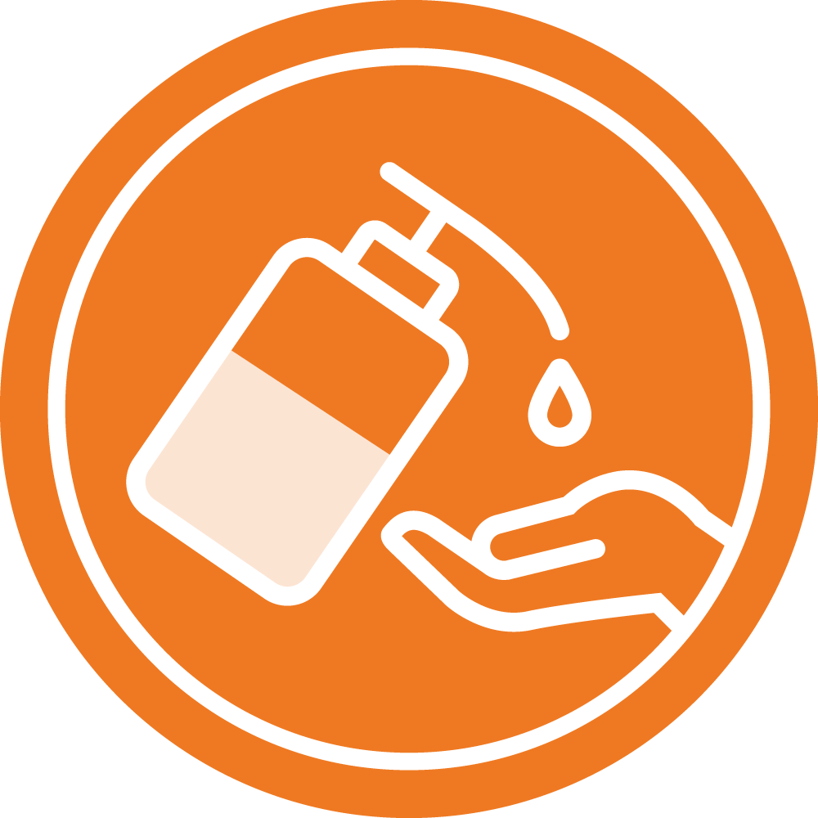


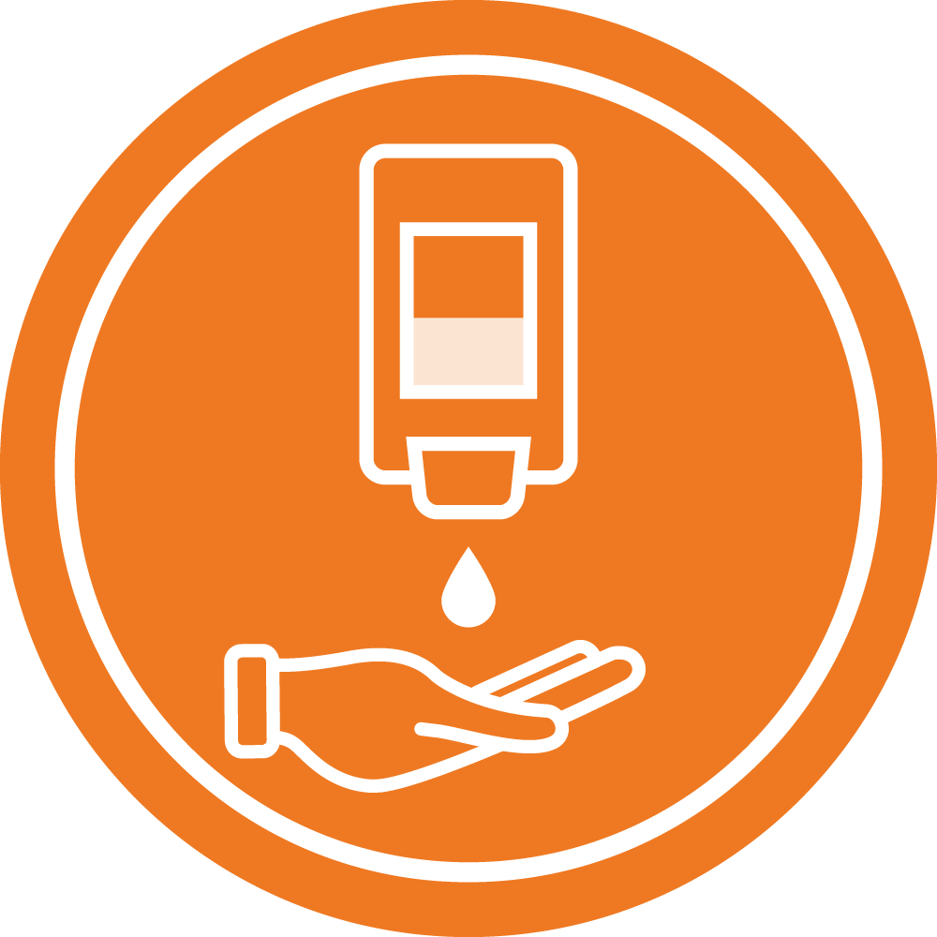

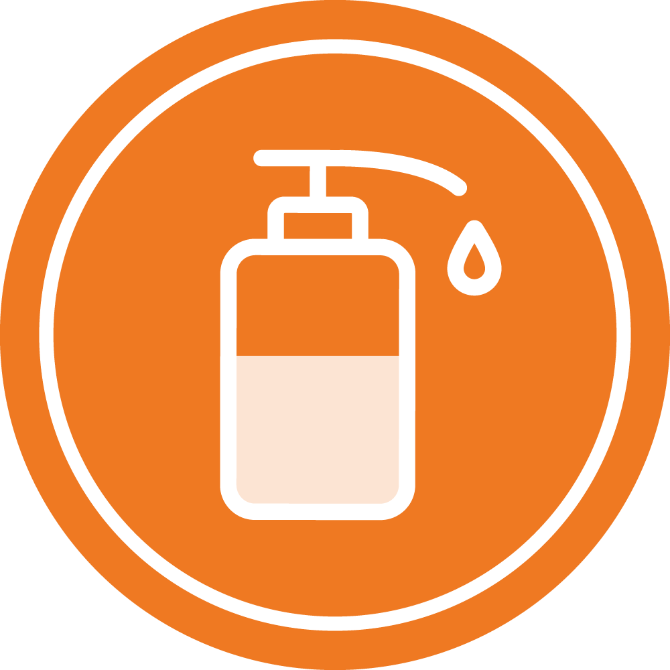



When people seek health care they are hoping to get better.
Too often, they actually end up getting new infections - sometimes fatal.
Because of poor hygiene
in health care facilities.
One way health care facilities can help stop this is by making sure that all health workers have access to the right hand hygiene and hand cleaning products.
Soap, water, clean towels – or alcohol based handrub.
By making sure that facilities are designed to make it easy for health workers to clean their hands when and where they need to.
And by making sure they know how to use them effectively.
There's a reason alcohol based handrub
is listed as a WHO Essential Medicine.
It can save lives!

