Slide 1
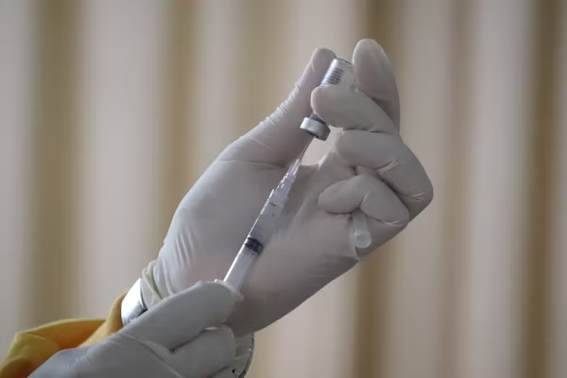
Vaccine
Effectiveness:
  Influenza A virus
  Coronavirus
  Ebola virus
  Hepatitis B virus

Slide 2
Vaccine
Effectiveness:
  Influenza A virus
  Coronavirus
  Ebola virus
  Hepatitis B virus

Slide 3
Antiserum
Effectiveness:
  Influenza A virus
  Coronavirus
  Ebola virus
  Hepatitis B virus

Slide 4
Antiserum
Effectiveness:
  Influenza A virus
  Coronavirus
  Ebola virus
  Hepatitis B virus

Slide 5
Vaccine
Effectiveness:
  Hepatitis A virus
  Chickenpox virus
  Human papillomavirus
  Measles virus

Slide 6
Vaccine
Effectiveness:
  Hepatitis A virus
  Chickenpox virus
  Human papillomavirus
  Measles virus

Slide 7
Antiserum
Effectiveness:
  Hepatitis A virus
  Chickenpox virus
  Human papillomavirus
  Measles virus

Slide 8
Antiserum
Effectiveness:
  Hepatitis A virus
  Chickenpox virus
  Human papillomavirus
  Measles virus

Slide 9
Vaccines
Effectiveness:
  Polio virus
  Mumps virus
  Staphylococcus
  Streptococcus

Slide 10
Vaccines
Effectiveness:
  Polio virus
  Mumps virus
  Staphylococcus
  Streptococcus

Slide 11
Antiserum
Effectiveness:
  Polio virus
  Mumps virus
  Staphylococcus
  Streptococcus

Slide 12
Antiserum
Effectiveness:
  Polio virus
  Mumps virus
  Staphylococcus
  Streptococcus

Slide 13
Vaccines
Effectiveness:
  Escherichia coli
  Salmonella
  Shigella
  Clostridium

Slide 14
Vaccines
Effectiveness:
  Escherichia coli
  Salmonella
  Shigella
  Clostridium

Slide 15
Antiserum
Effectiveness:
  Escherichia coli
  Salmonella
  Shigella
  Clostridium

Slide 16
Antiserum
Effectiveness:
  Escherichia coli
  Salmonella
  Shigella
  Clostridium

Slide 17
Vaccines
Effectiveness:
  Pneumococcus
  Bacillus
  Helicobacter pylori
  Mycobacterium tuberculosis

Slide 18
Vaccines
Effectiveness:
  Pneumococcus
  Bacillus
  Helicobacter pylori
  Mycobacterium tuberculosis

Slide 19
Antiserum
Effectiveness:
  Pneumococcus
  Bacillus
  Helicobacter pylori
  Mycobacterium tuberculosis

Slide 20
Antiserum
Effectiveness:
  Pneumococcus
  Bacillus
  Helicobacter pylori
  Mycobacterium tuberculosis

Slide 21
Vaccines
Effectiveness:
  Vibrio cholerae
  Legionella
  Staphylococcus
  Neisseria meningitidis

Slide 22
Vaccines
Effectiveness:
  Vibrio cholerae
  Legionella
  Staphylococcus
  Neisseria meningitidis

Slide 23
Antiserum
Effectiveness:
  Vibrio cholerae
  Legionella
  Staphylococcus
  Neisseria meningitidis

Slide 24
Antiserum
Effectiveness:
  Vibrio cholerae
  Legionella
  Staphylococcus
  Neisseria meningitidis

